Slide 1
MY JOURNAL TO PYTHON
Pologon, Angela Mae 安希佐 - 4110E229

Slide 2


Agenda
A
Python
Input and output: input() and print()
Data types: numerisc, strings, list , dict
Operators ON data type:
CONTROLS : IF- | IF –ELSIF |-F-ELSE
LOOP: FOR |WHILE | RANGE() | BREAK | CONTINUE
FUNCTION:
PARAMETERS(ARGUMETNS)
RECURSIVE FUNCTION
LAMBDA FUNCTION

Slide 3
WHAT IS PYTHON?
A popular programming language. It was created by Guido van Rossum, and released in 1991.
web development (server-side)
software development,
mathematics,
system scripting.

Slide 4
What can Python do?

Slide 5
Python can be used on a server to create web applications.
Python can be used alongside software to create workflows.
Python can connect to database systems. It can also read and modify files.
Python can be used to handle big data and perform complex mathematics.
Python can be used for rapid prototyping, or for production-ready software development.
https://www.w3schools.com/python/python_intro.asp

Slide 6
WHY TO LEARN PYTHON?
has a simple syntax similar to the English language.
has syntax that allows developers to write programs with fewer lines than some other programming languages.
runs on an interpreter system, meaning that code can be executed as soon as it is written. This means that prototyping can be very quick.
can be treated in a procedural way, an object-oriented way or a functional way.
Possible to write Python in an Integrated Development Environment, such as Thonny, Pycharm, Netbeans or Eclipse which are particularly useful when managing larger collections of Python files.
was designed for readability, and has some similarities to the English language with influence from mathematics.
uses new lines to complete a command, as opposed to other programming languages which often use semicolons or parentheses
relies on indentation, using whitespace, to define scope; such as the scope of loops, functions and classes. Other programming languages often use curly-brackets for this purpose.

Slide 7
Python Syntax
“
”

Slide 8
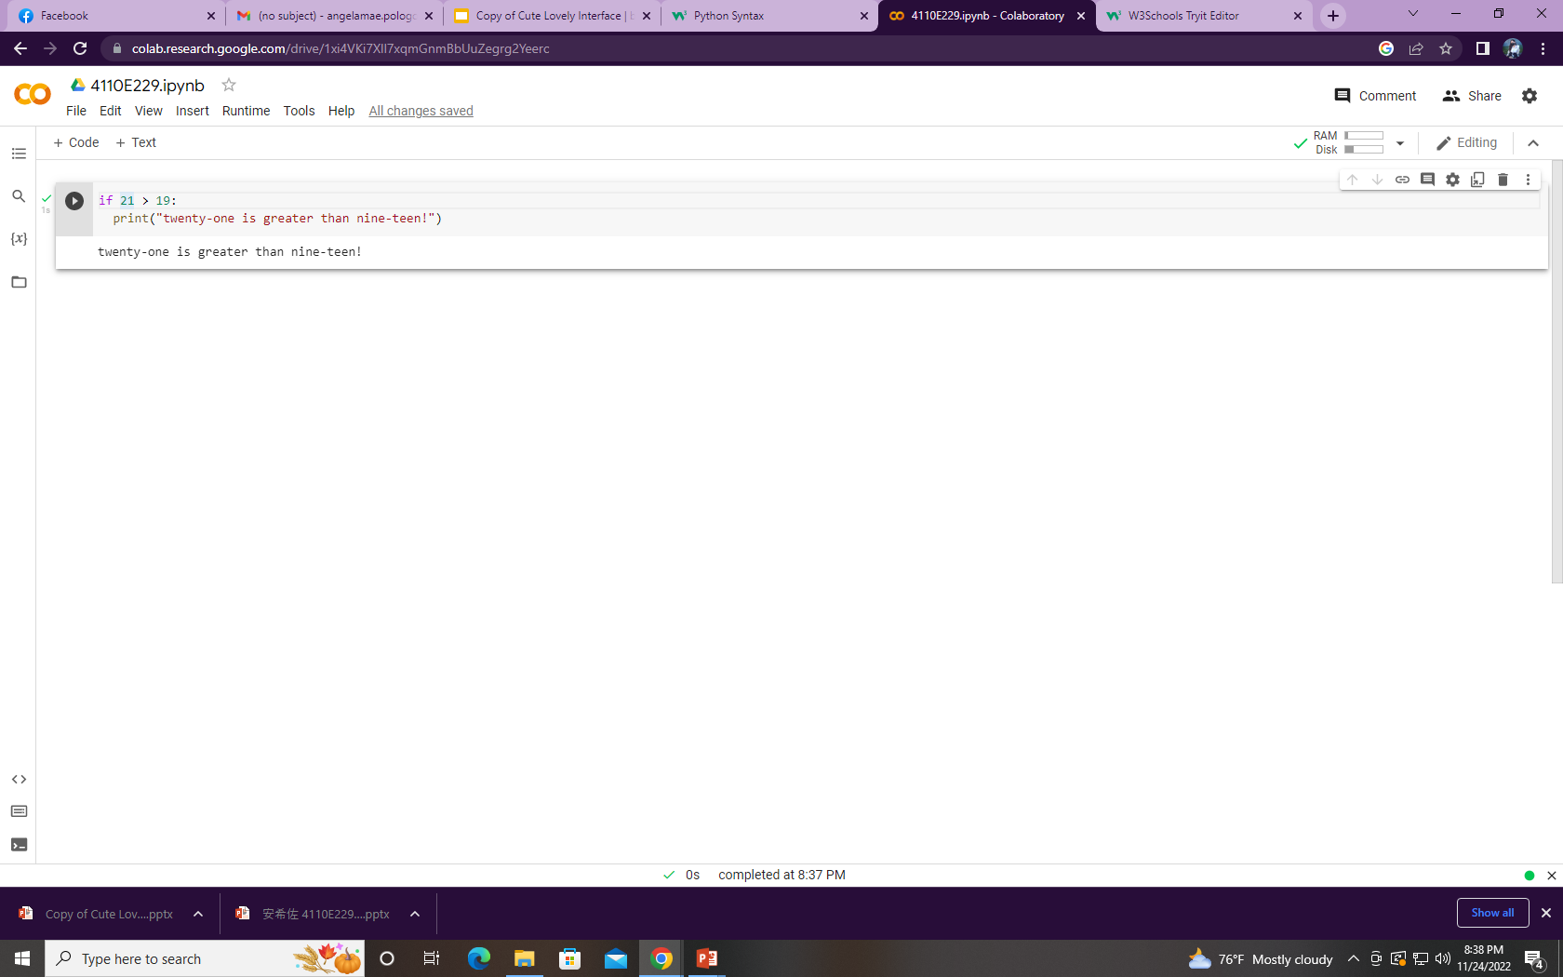
Python syntax can be executed by writing directly in the Command Line:

Slide 9
“
Python Comments
”

Slide 10
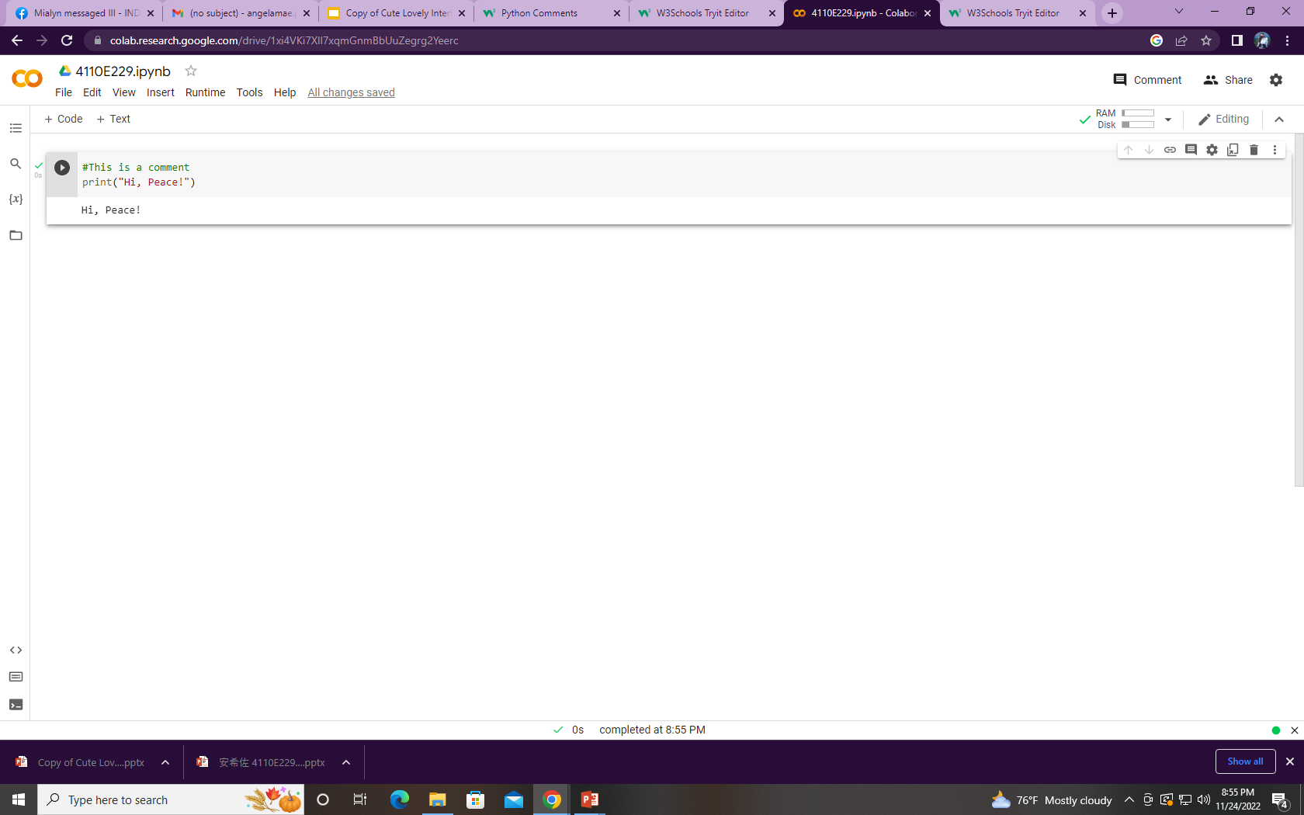
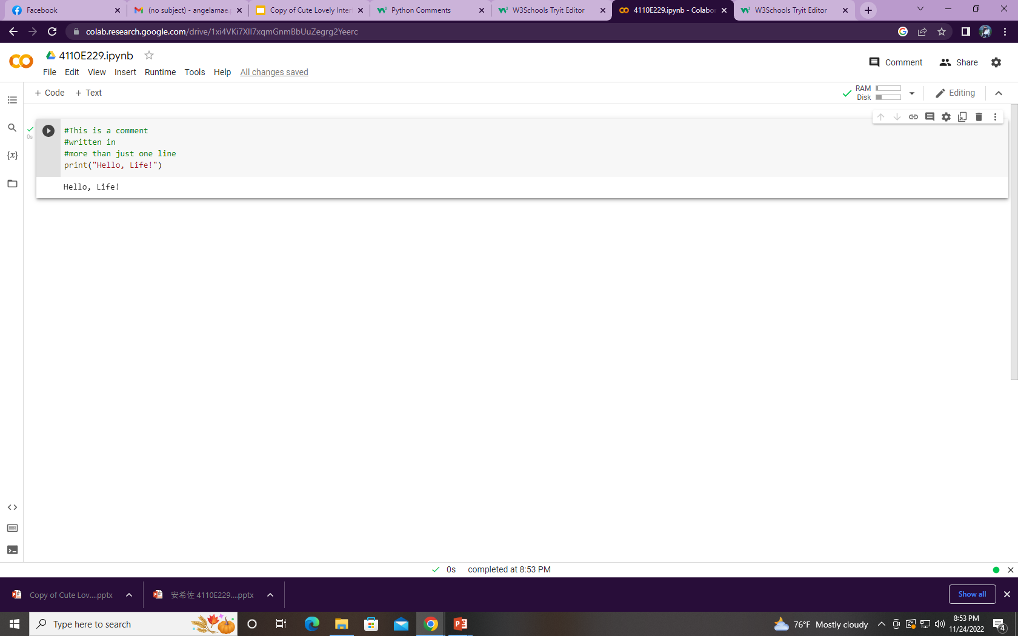
used to make the code more readable
used to explain Python code.
#This is a comment print("Hello, World!")
Multi Line Comments
Python does not really have a syntax for multi line comments.

Slide 11
PYTHON VARIABLES
“
”

Slide 12
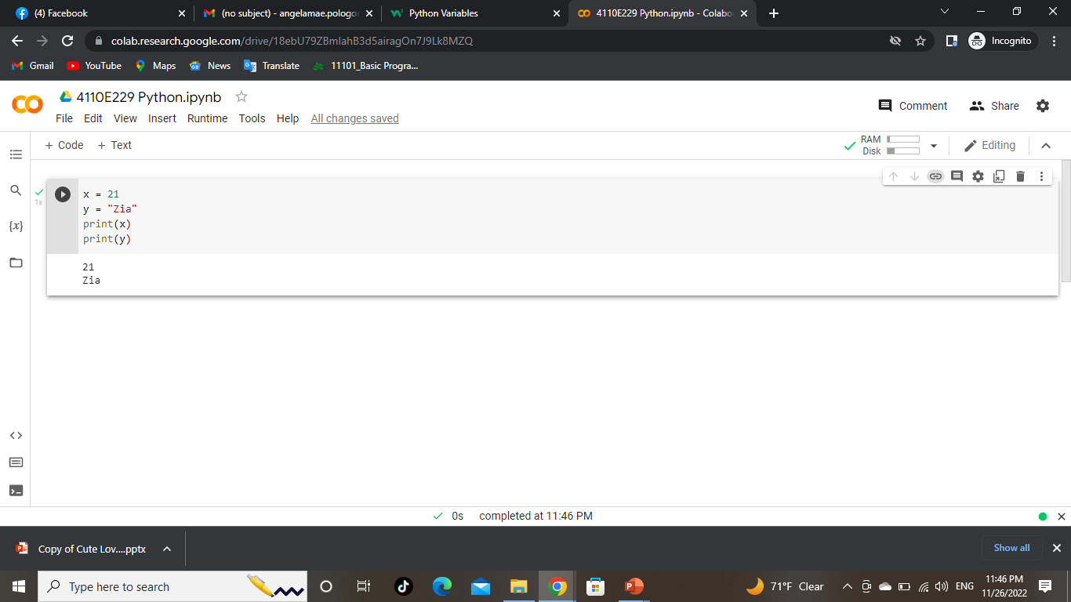
Creating Variables
Variables are containers for storing data values.

Slide 13
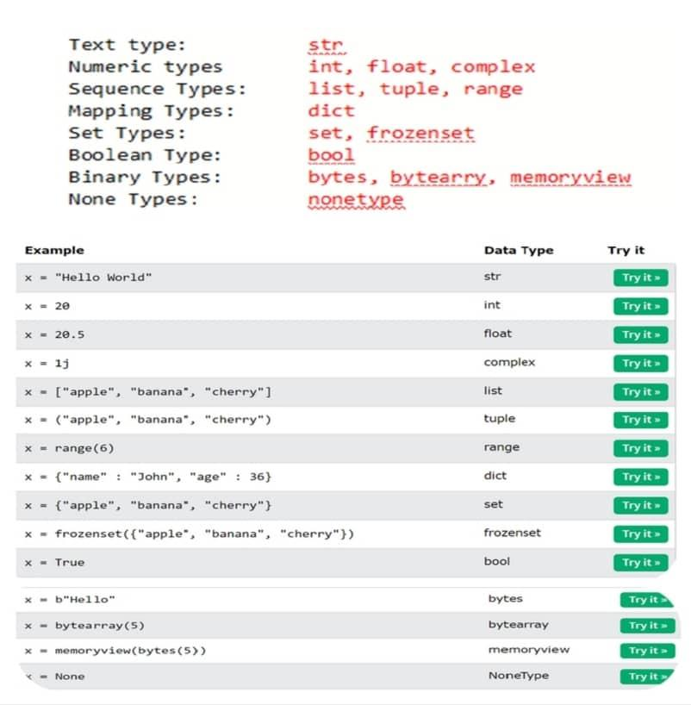
BUILT-IN DATA TYPES
In programming, data type is an important concept.
Variables can store data of different types, and different types can do different things.
Python has the following data types built-in by default,

Slide 14
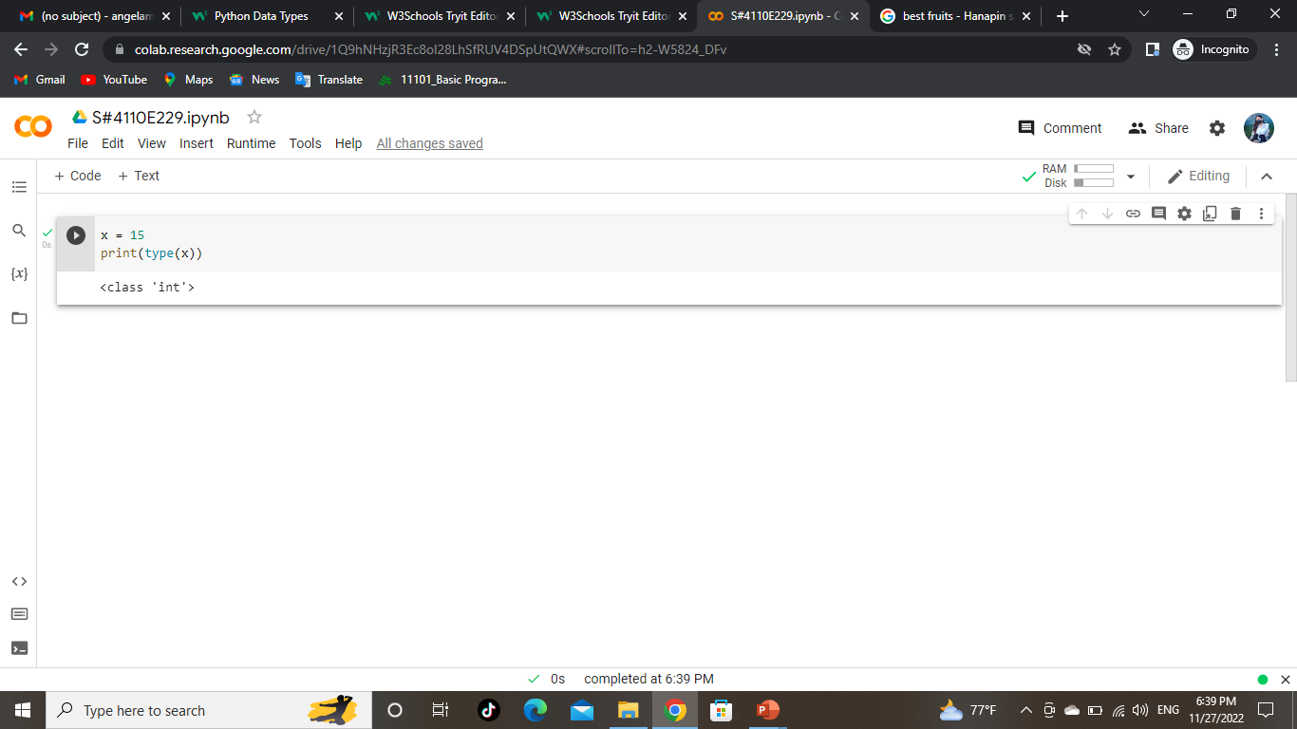
GETTING THE DATA TYPE

Slide 15
SETTING THE SPECIFIC DATA TYPE
“
”

Slide 16
F

Slide 17
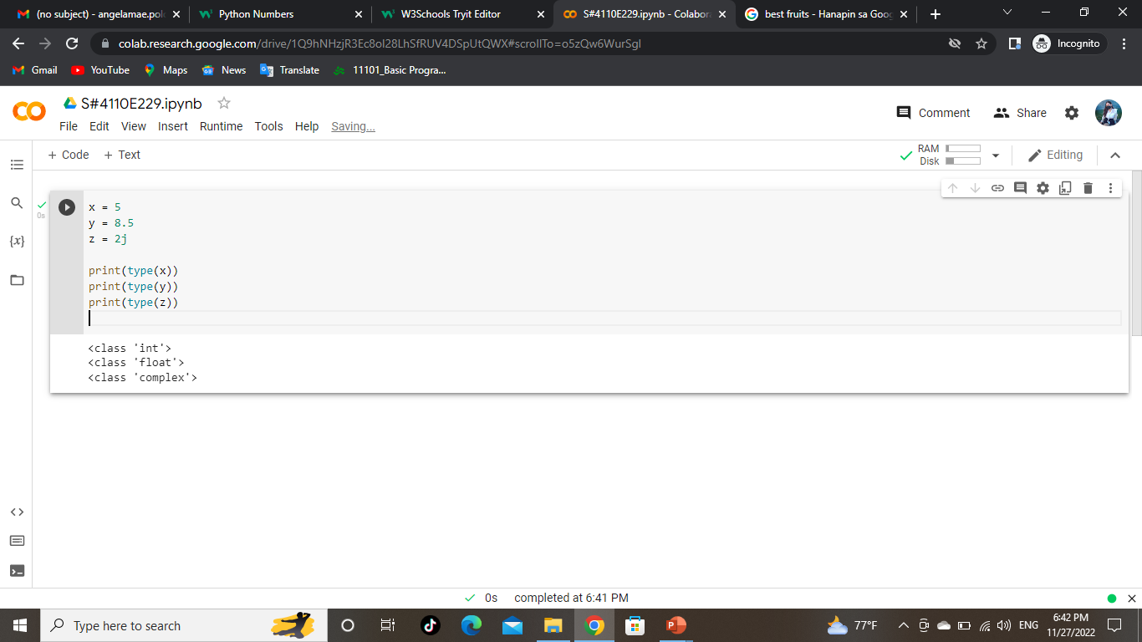
PYTHON NUMBERS
At Contoso, we believe in giving 110%. By using our next-generation data architecture, we help organizations virtually manage agile workflows. We thrive because of our market knowledge and great team behind our product. As our CEO says, "Efficiencies will come from proactively transforming how we do business."

Slide 18
Input & Output: input() and print()
“
”

Slide 19



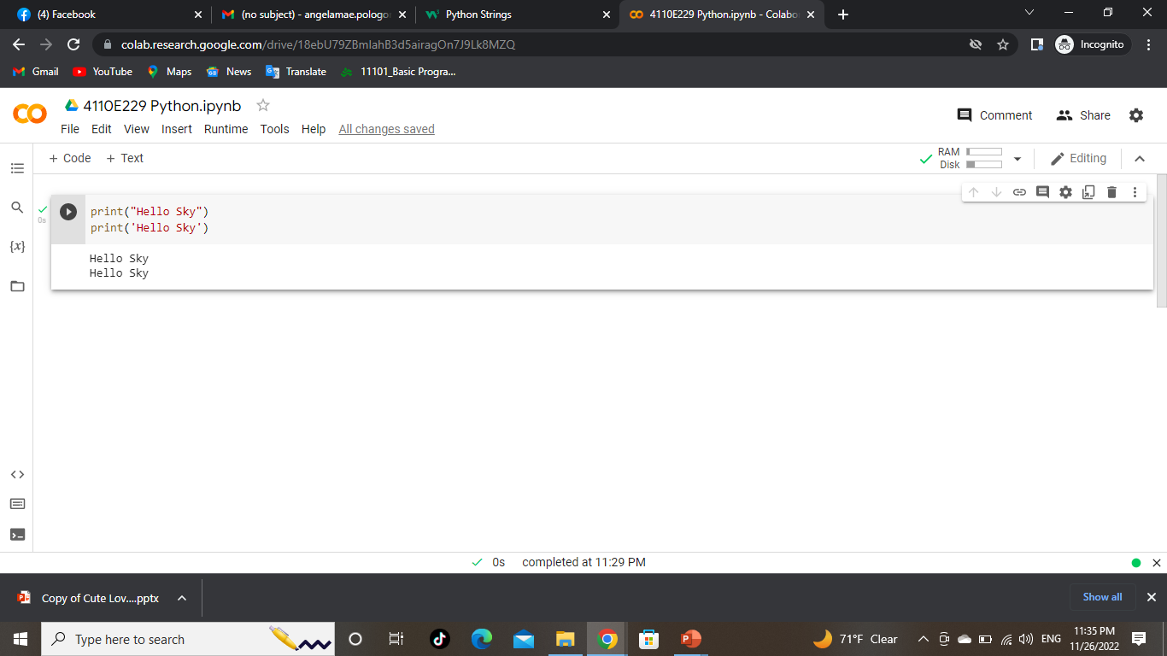


PYTHON STRINGS
Strings in python are surrounded by either single quotation marks, or double quotation marks.
‘Hi Sky' is the same as “Hi Sky".
You can display a string literal with the print() function:
01
02
03
04

Slide 20

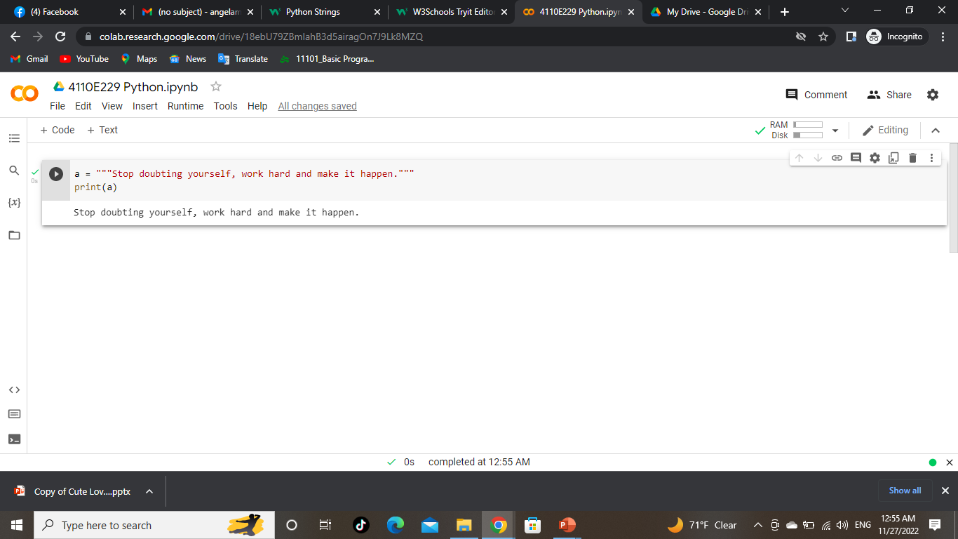
ASSIGN STRING TO A VARIABLE
Multiline Strings
01
Mercury is the closest planet to the Sun
02
three double quotes
03
04
You can return a range of characters by using the slice syntax.
Specify the start index and the end index, separated by a colon, to return a part of the string.
You can assign a multiline string to a variable by using three quotes

Slide 21
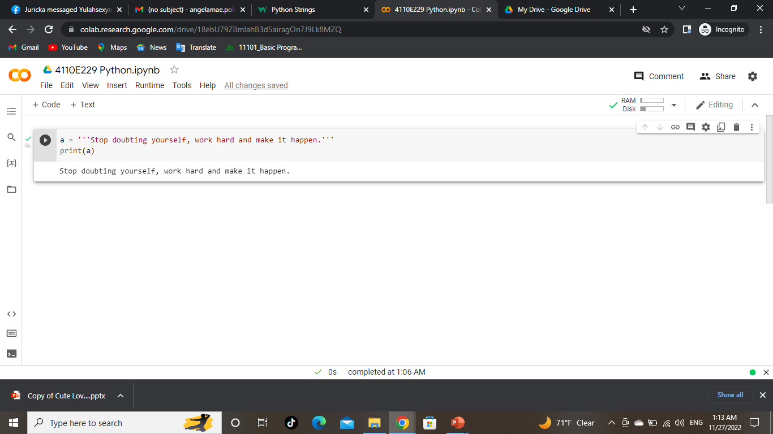
Multiline Strings
01
02
You can return a range of characters by using the slice syntax.
Specify the start index and the end index, separated by a colon, to return a part of the string.
03
04
three single quotes

Slide 22




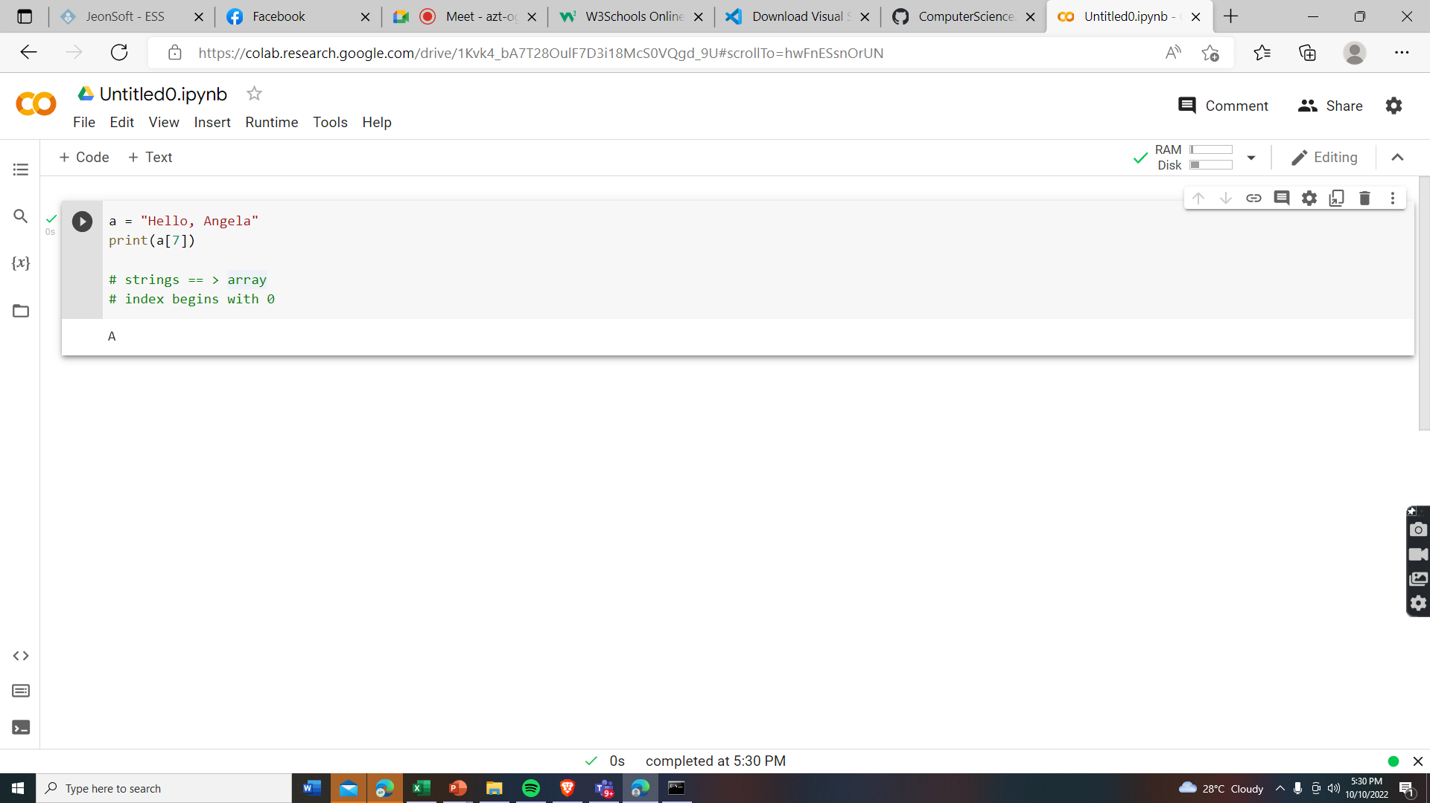




STRINGS IN PYTHON ARE ARRAYS OF BYTES. REPRESENTING UNICODE CHARACTERS

Slide 23
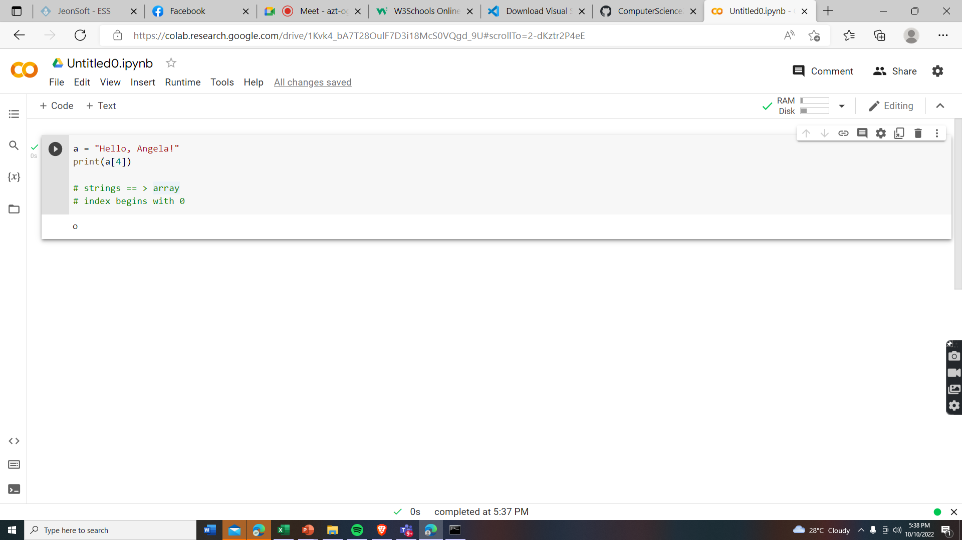
Strings are Arrays ==> access the element of arrays
Python does not have a character data type, a single character is simply a string with a length of 1

Slide 24



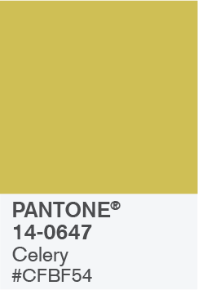
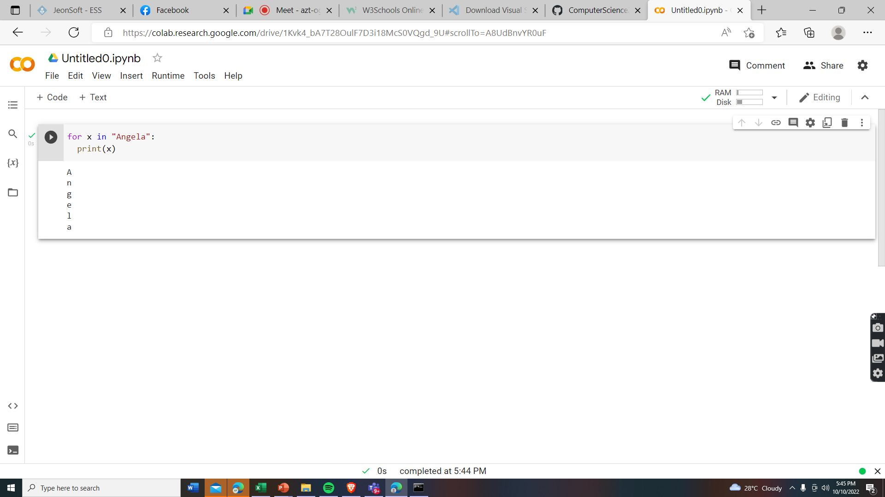
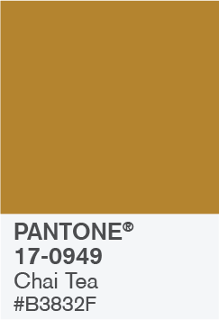


Looping Through a String

Slide 25
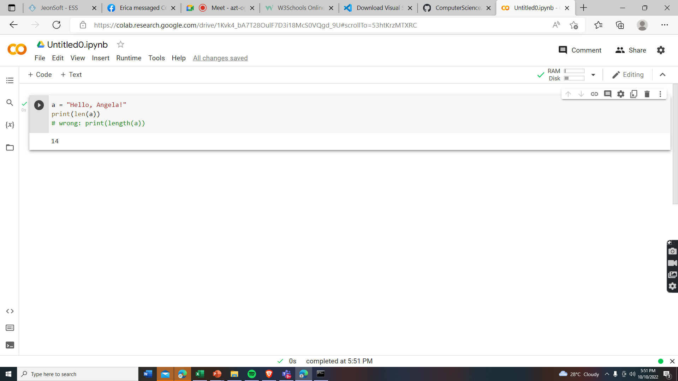

String Length:
To get the length of a string, use the len()function

Slide 26


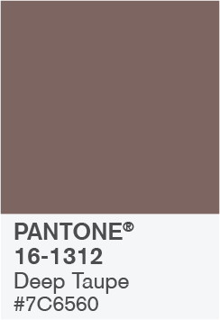

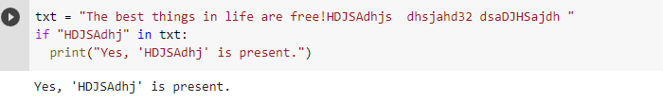


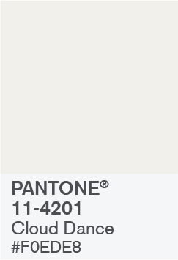
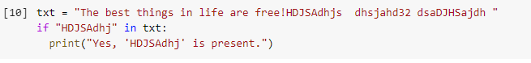
Check String: To check if a certain phrase or character is present in a string, we can use the keyword in.
keyword in vs if
True or False

Slide 27
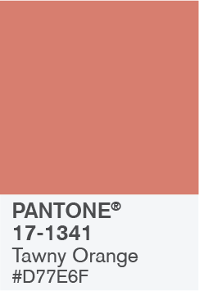
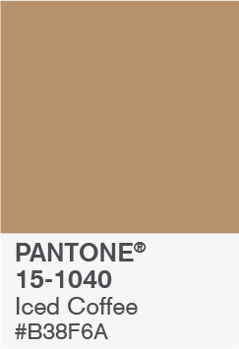

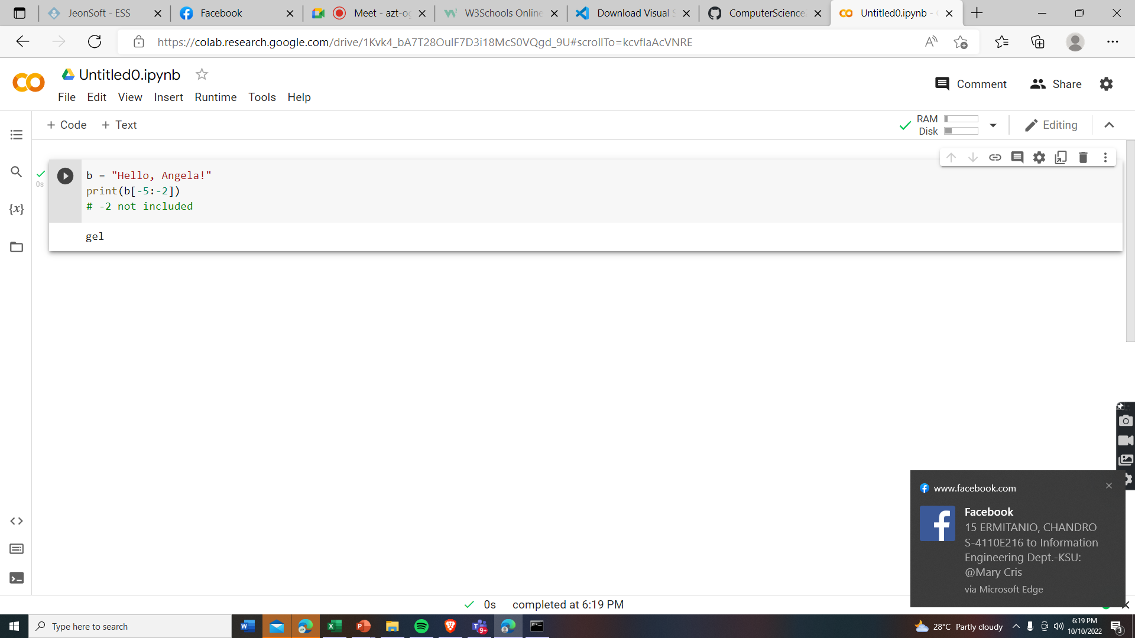




Negative indexing

Slide 28
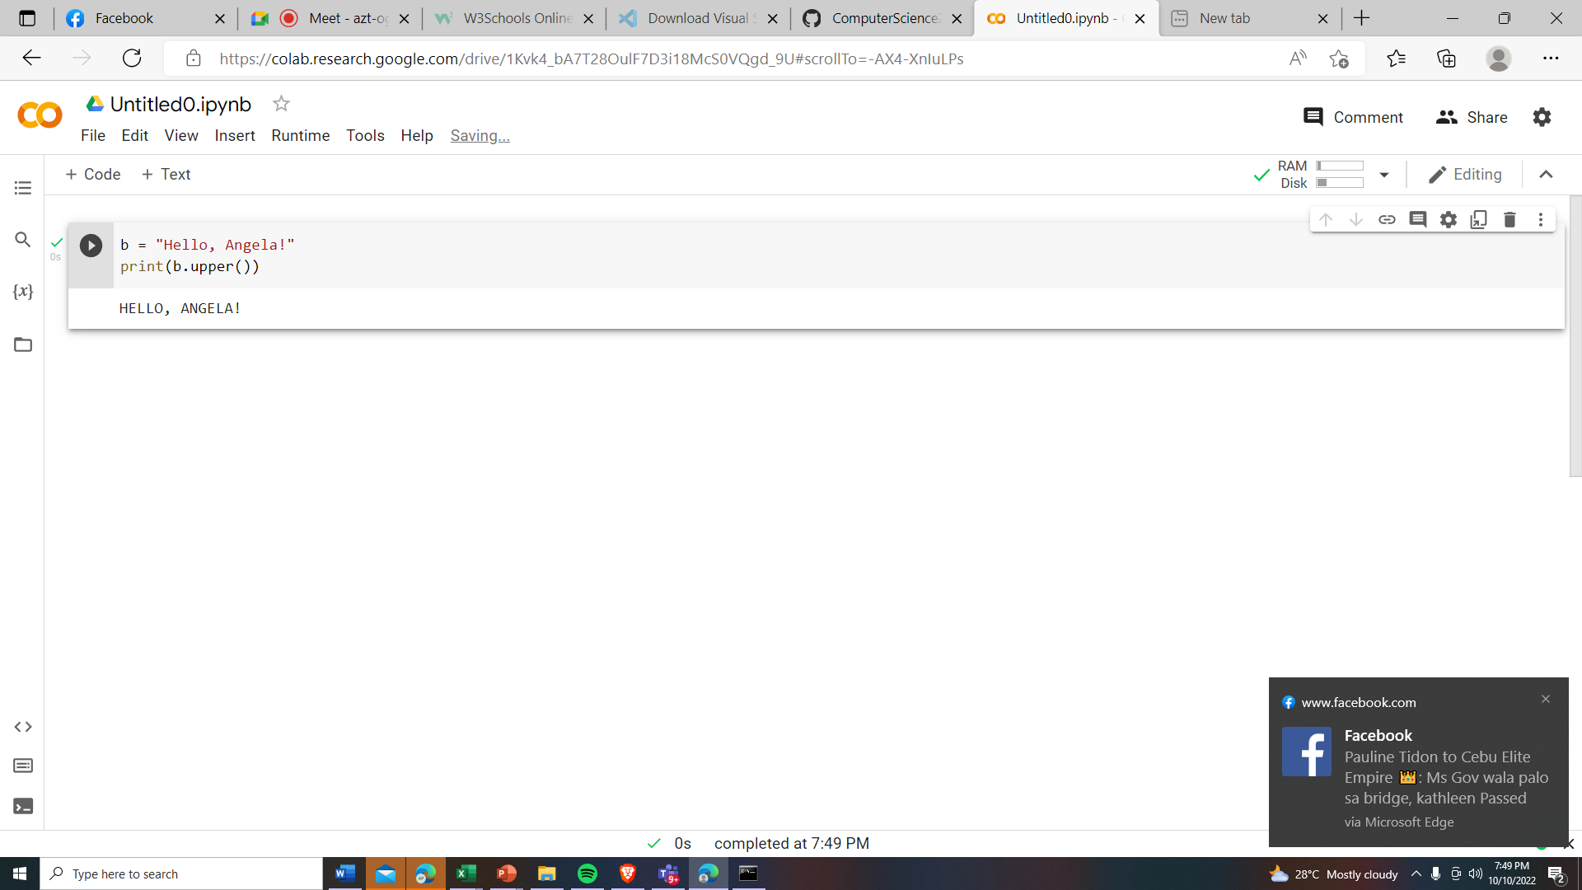
Python - Modify Strings
The upper() method returns the string in upper case:
The lower() method returns the string in lower case

Slide 29
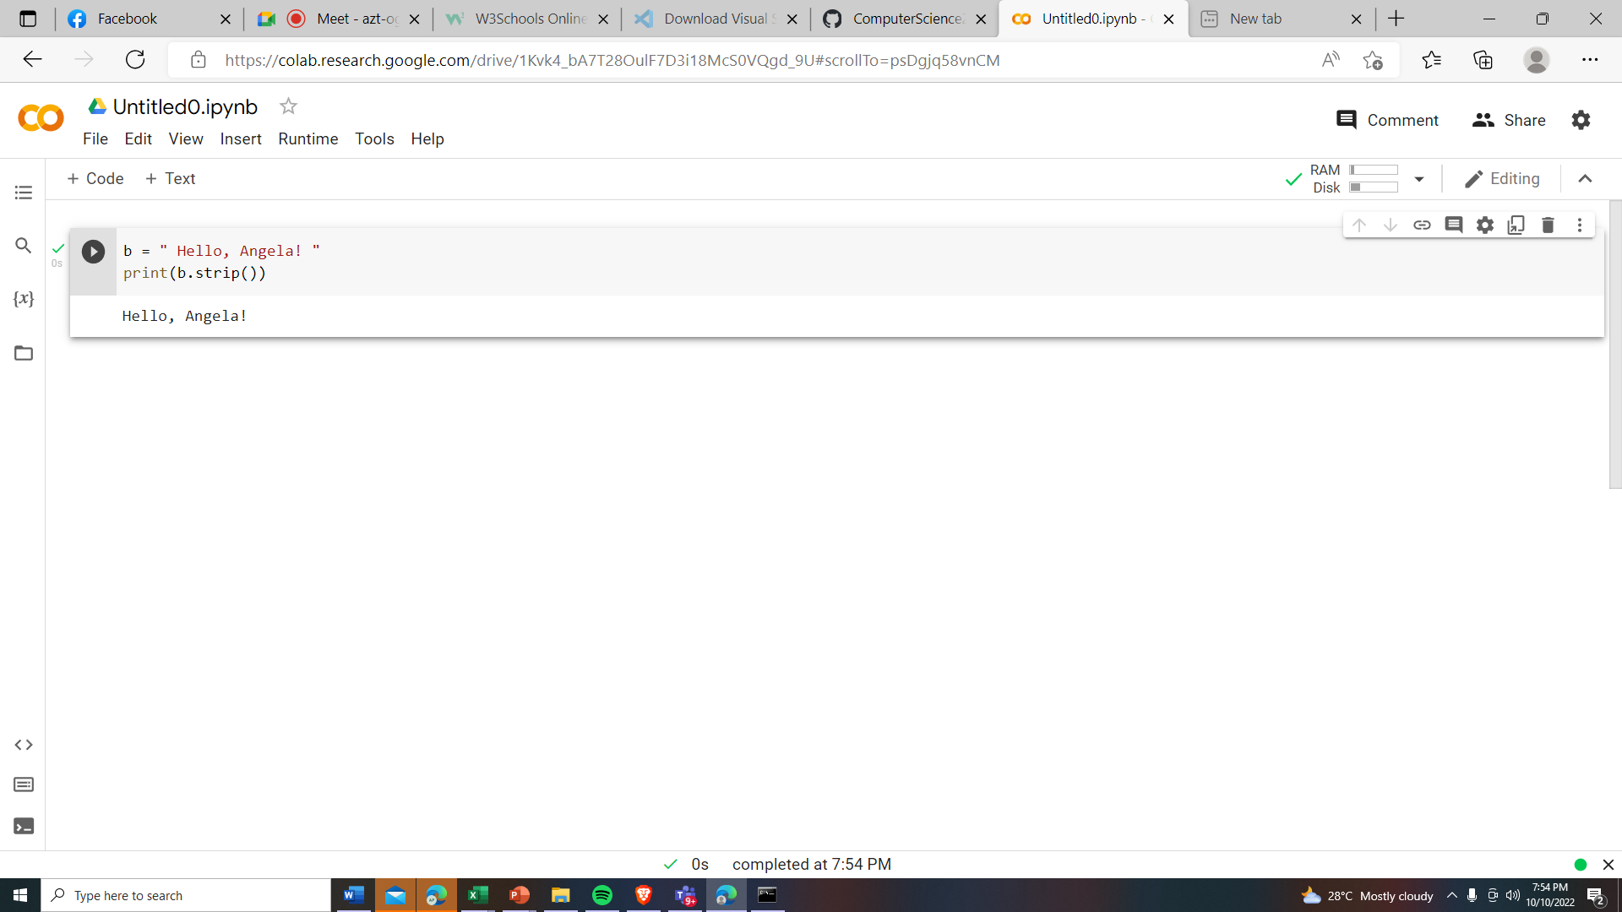
Remove Whitespace with STRIP () method
The strip() method removes any whitespace from the beginning or the end

Slide 30
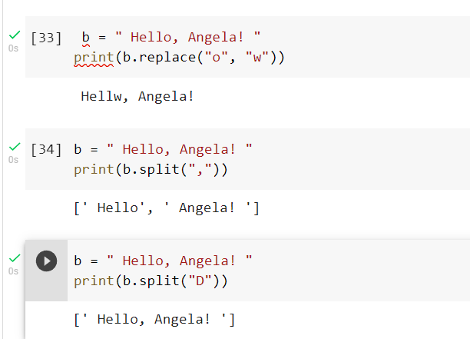
The replace() method replaces a string with another string
sepArator

Slide 31
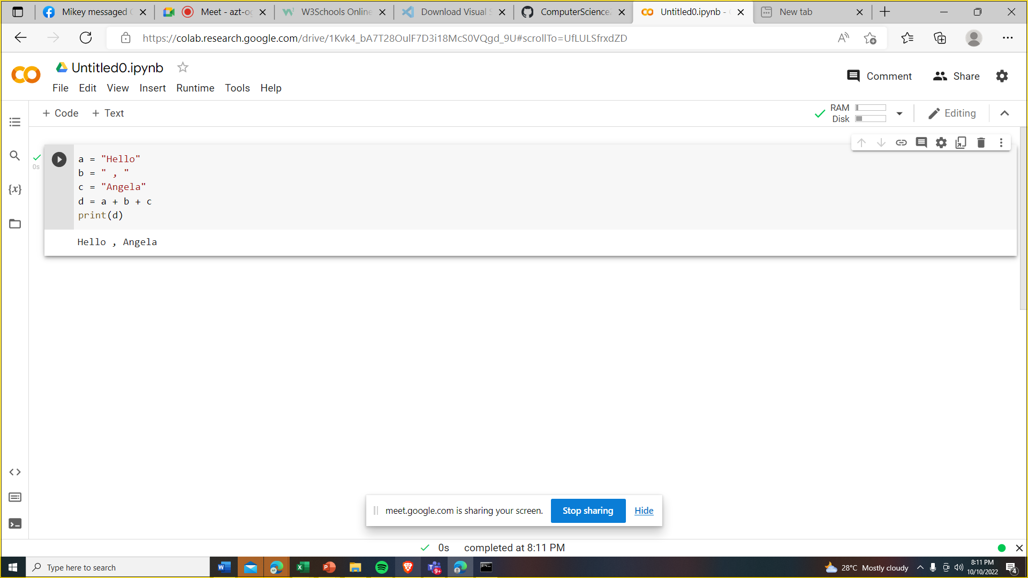
String Concatenation: To concatenate, or combine, two strings you can use the + operator.

Slide 32
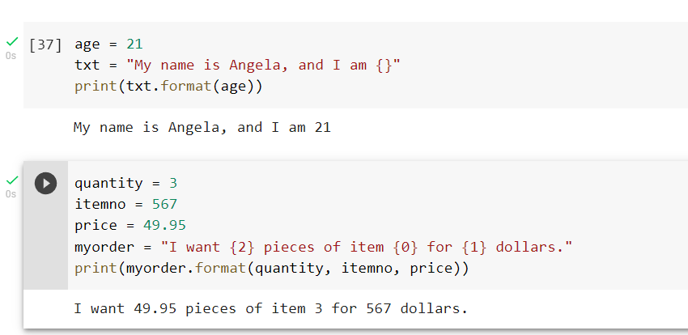
Python - Format - Strings

Slide 33
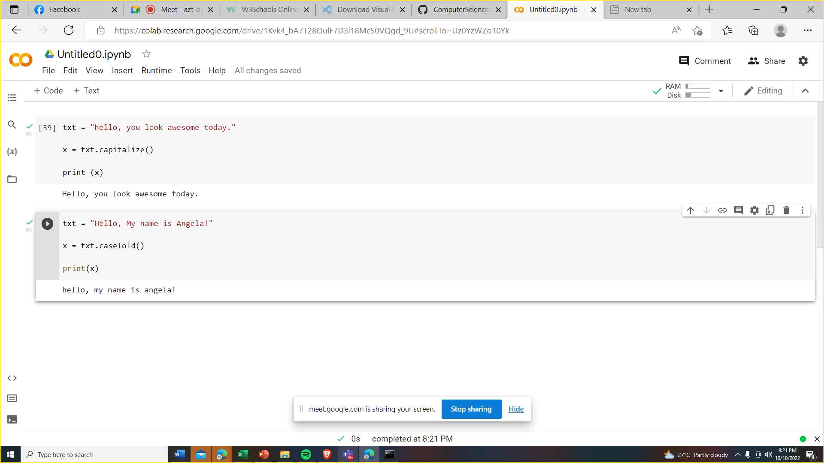
String Methods

Slide 34
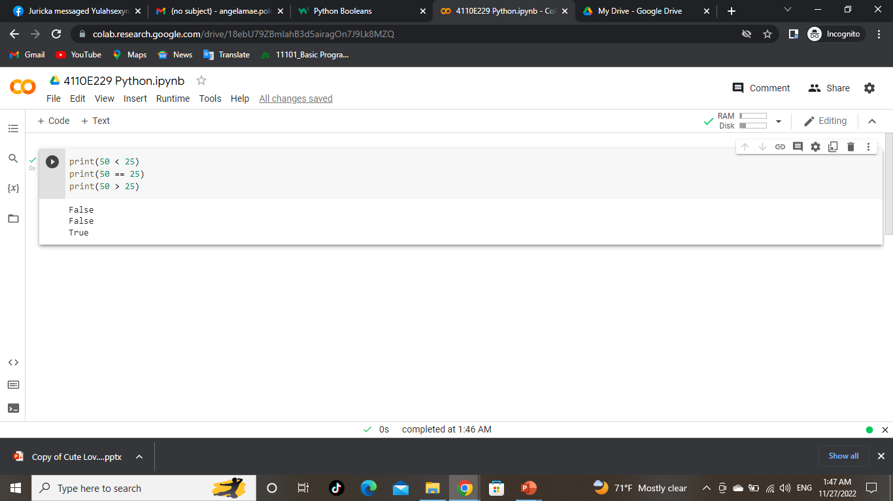
PYTHON BOOLEANS
01
Python only have two possible values:
True or False
02
Python only have two possible values:
True or False
03
04

Slide 35





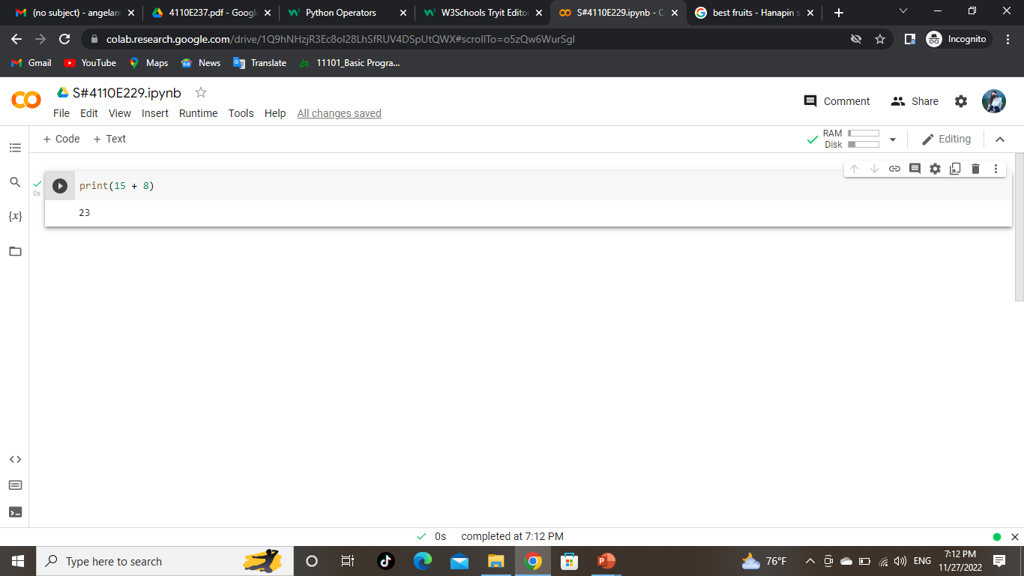


PYTHON OPERATORS
Operators are used to perform operations on variables and values.
In the example below, we use the + operator to add together two values:

Slide 36




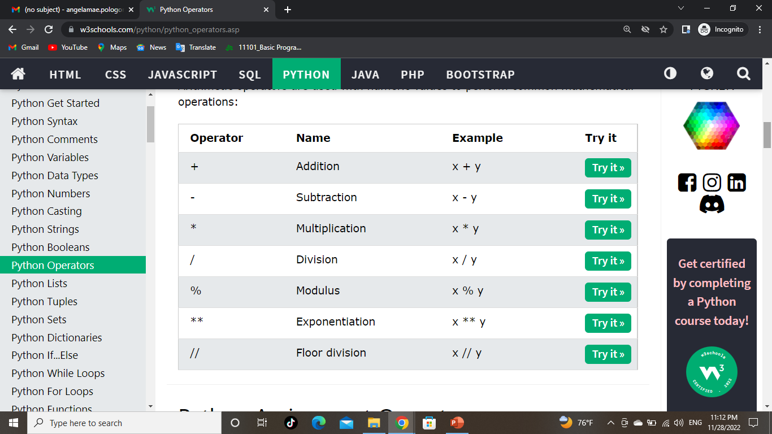
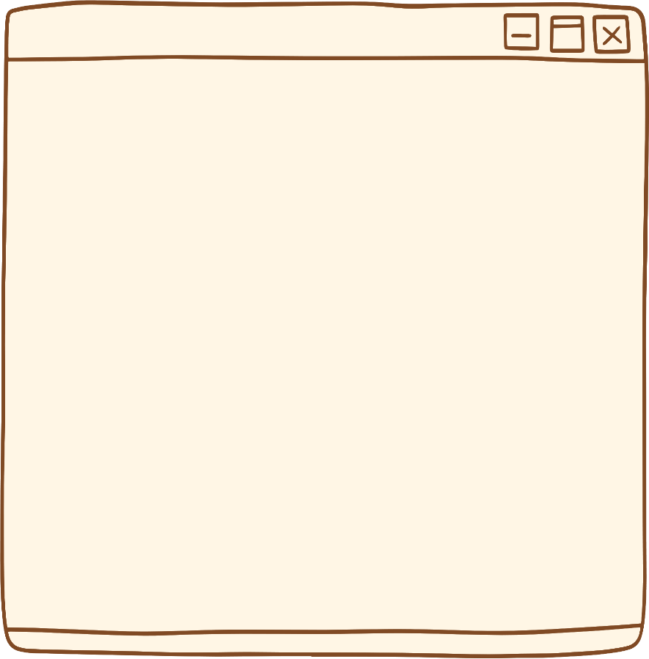


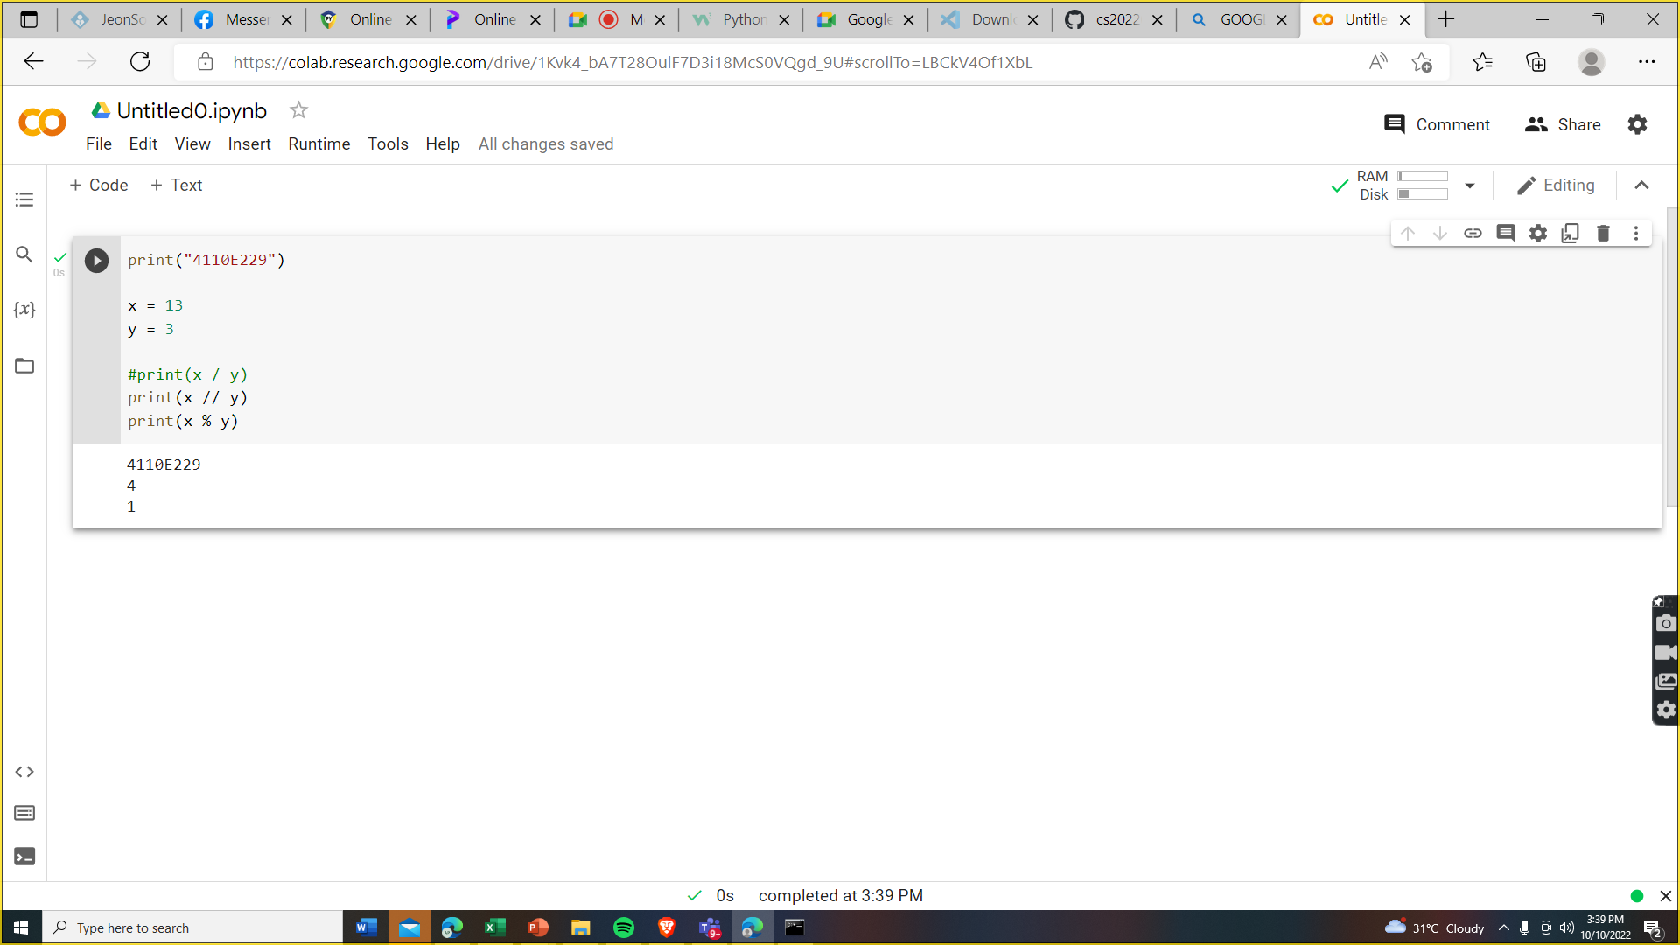


Python Arithmetic Operators:
Arithmetic operators are used with numeric values to perform common mathematical operations:

Slide 37
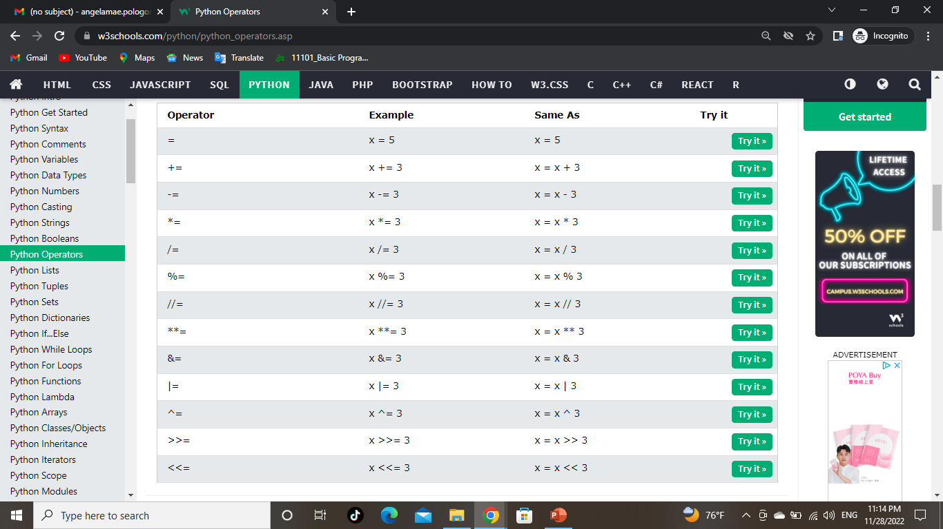
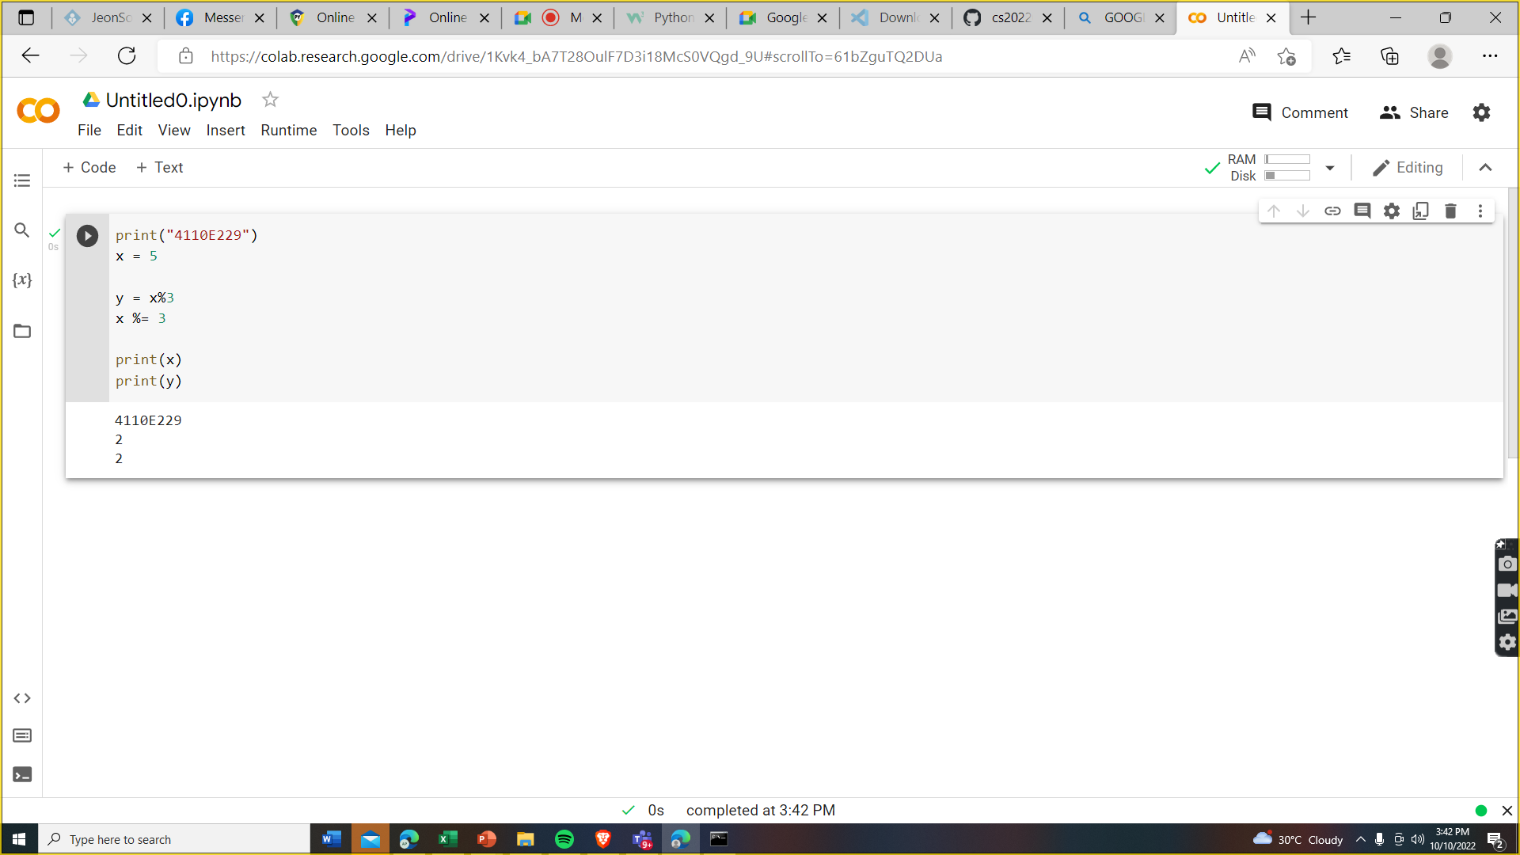
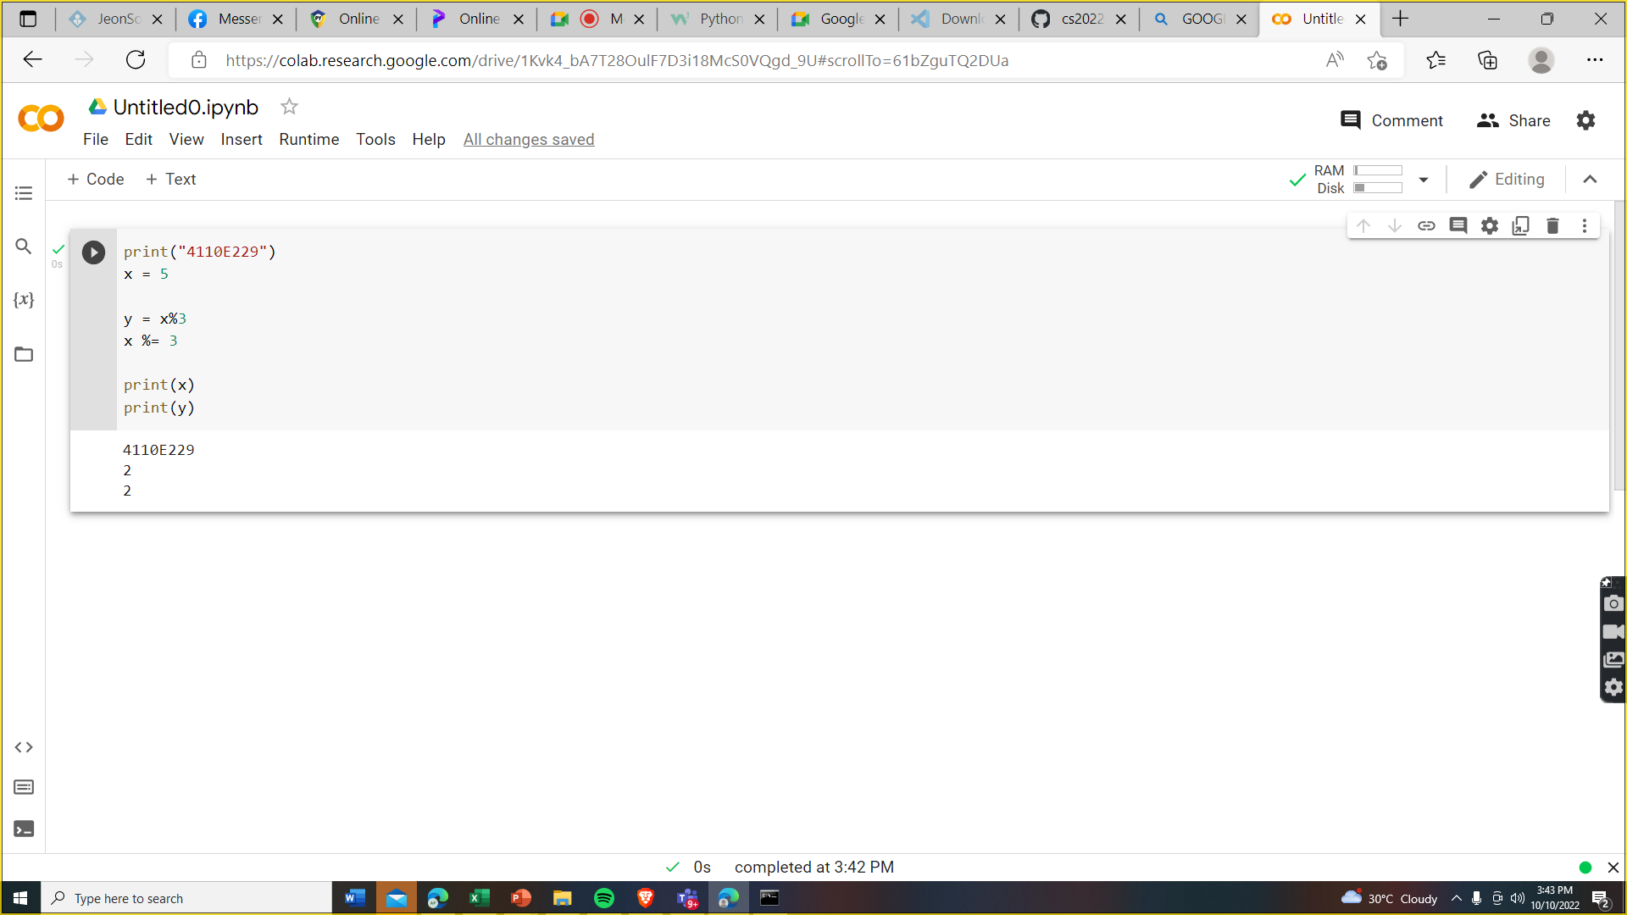

Python ASSIGNMENT Operators:
Assignment operators are used to assign values to variables:
Python Assignment Operators

Slide 38
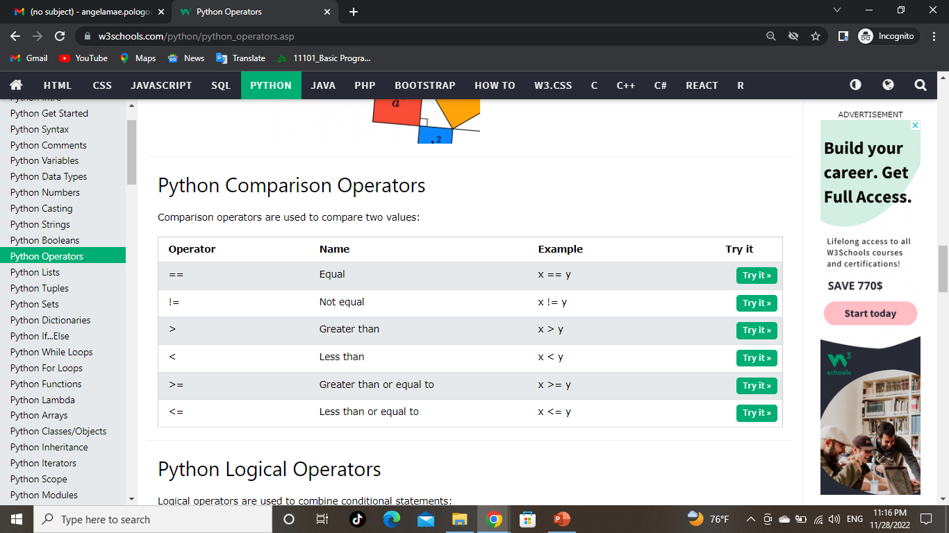
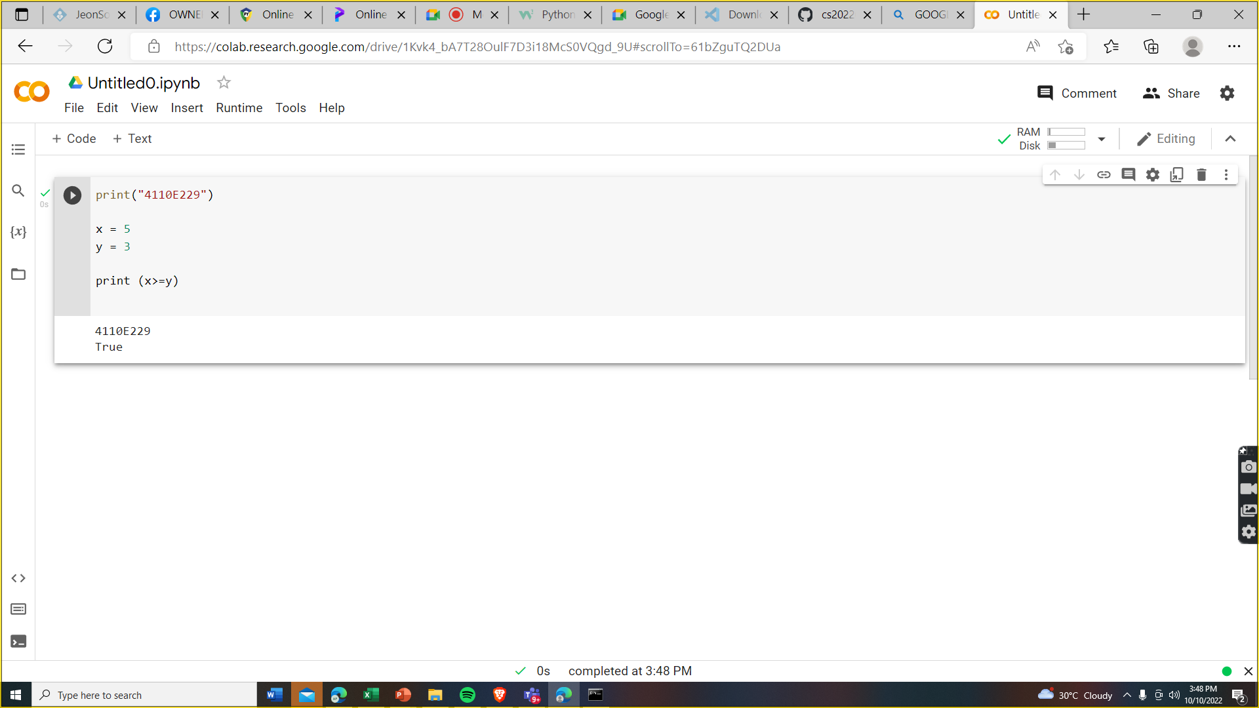
Python COMPARISON Operators:
Comparison operators are used to compare two values:
Python Assignment Operators

Slide 39
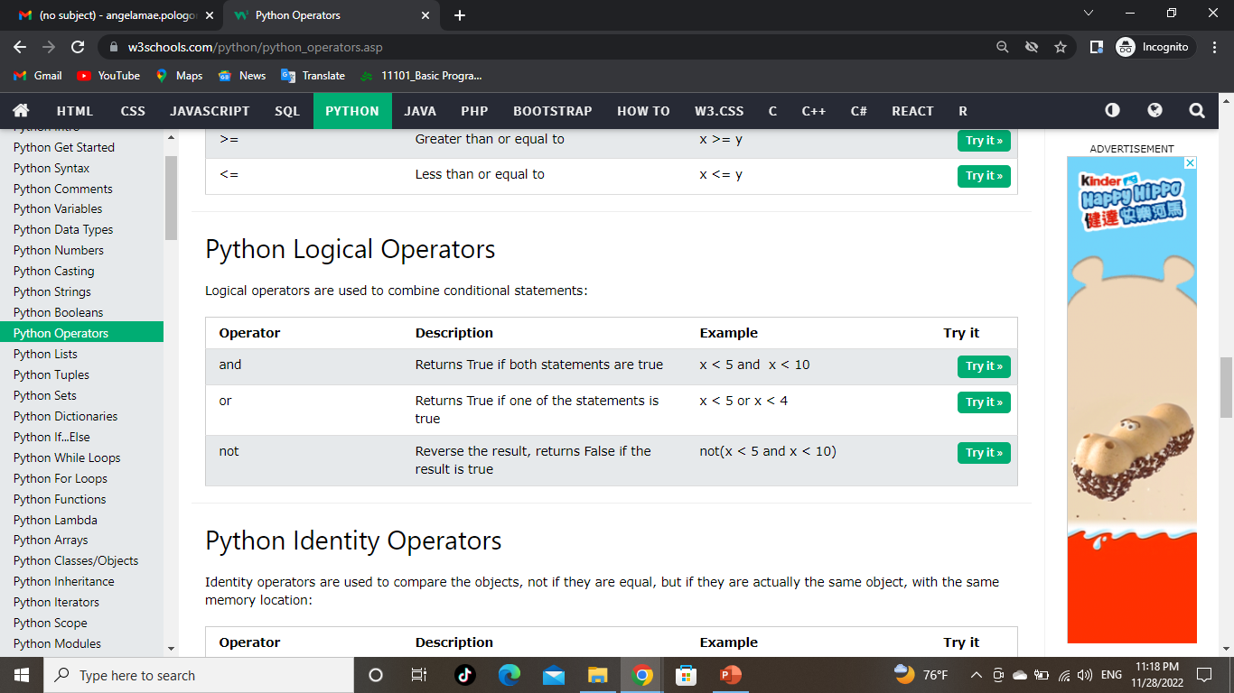

Python LOGICAL Operators:
Python Assignment Operators

Slide 40
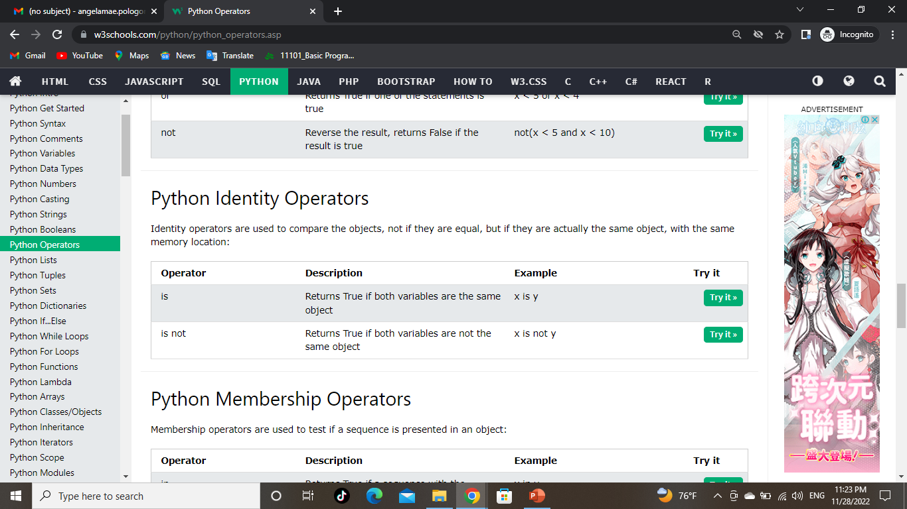

Python identity Operators:
Python Assignment Operators
Identity operators are used to compare the objects, not if they are equal, but if they are actually the same object, with the same memory location:

Slide 41
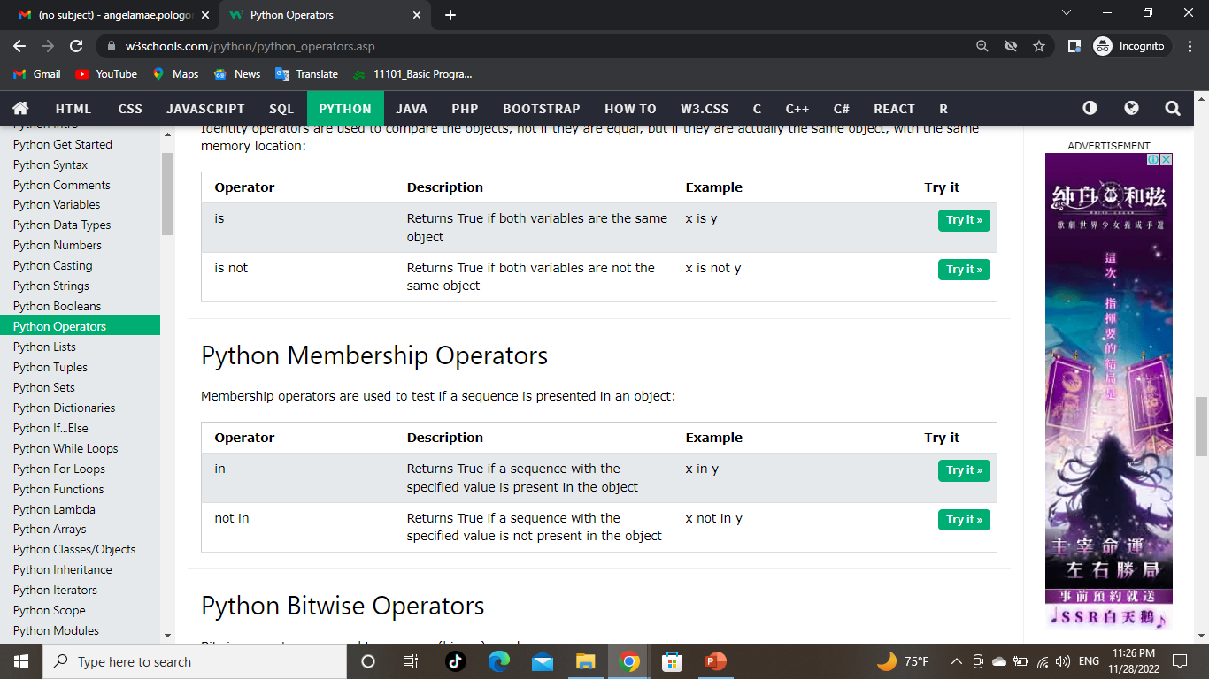
Python membership Operators:
Membership operators are used to test if a sequence is presented in an object:
Python Assignment Operators

Slide 42
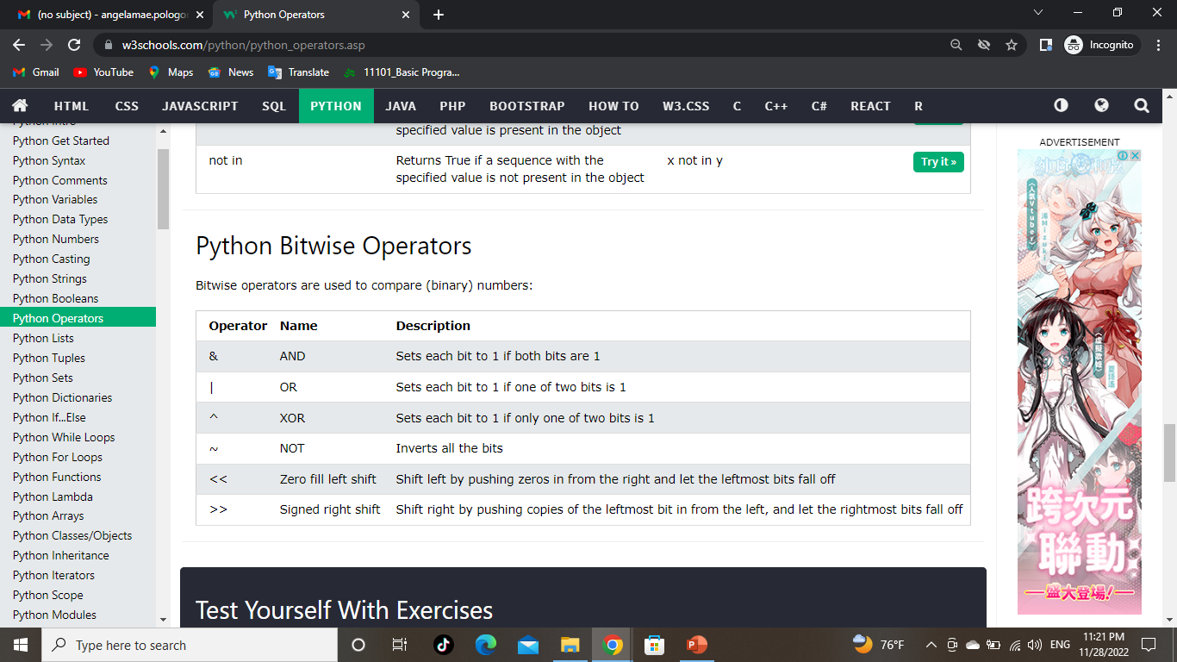
Python BITEWISE Operators:
Python Assignment Operators

Slide 43
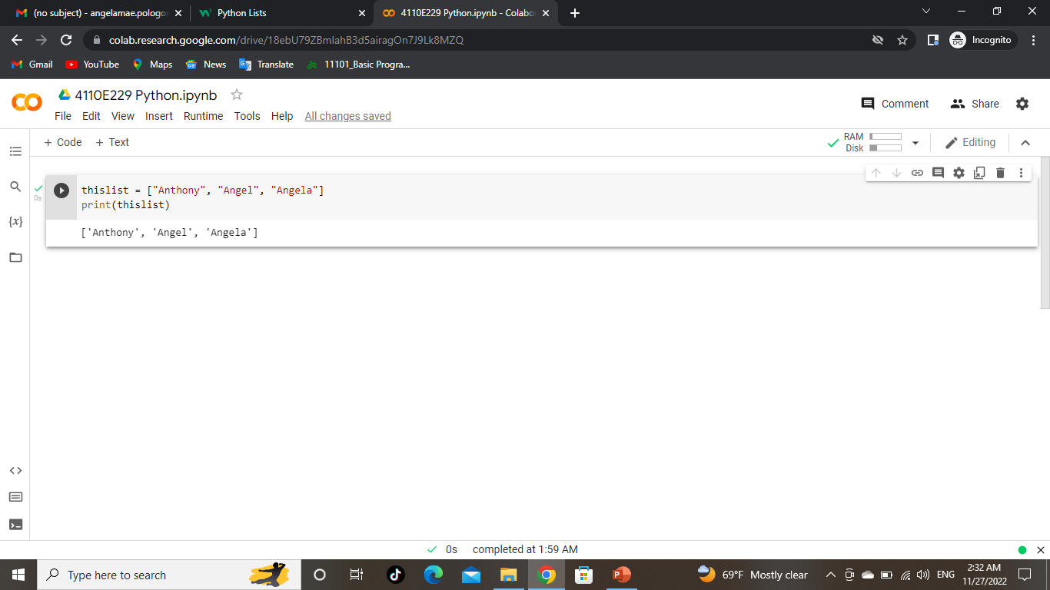
Python Lists
Lists are used to store multiple items in a single variable, one of 4 built-in data types in Python used to store collections of data, the other 3 are Tuple, Set, and Dictionary, all with different qualities and usage & lists are created using square brackets
01
02
MARS
Multiple Items can be kept in
a single variable by using lists
Despite being red, Mars is a cold place
03
04

Slide 44
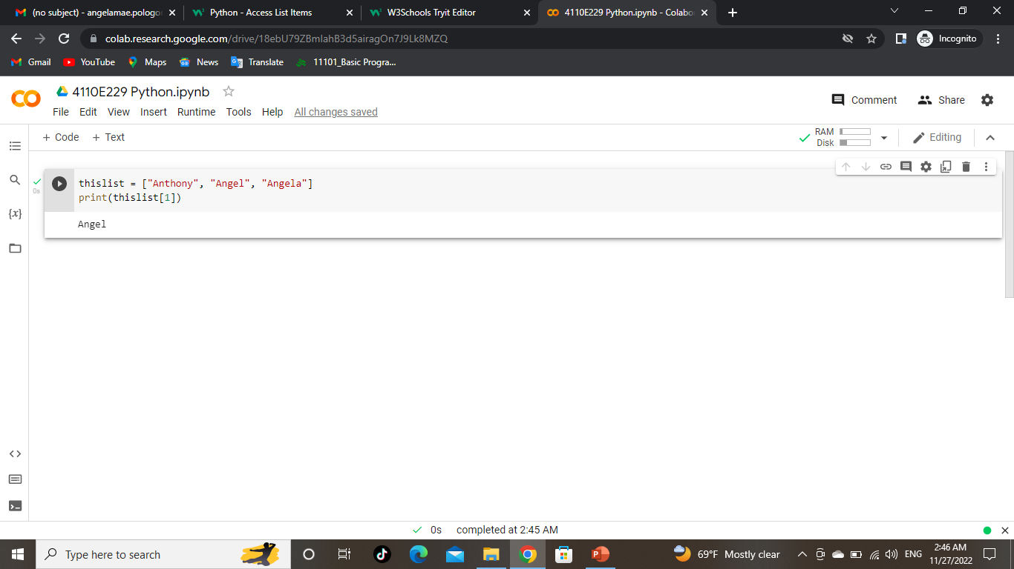
Python - Access List Items
List items are indexed and you can access them by referring to the index number:
01
02
03
04

Slide 45
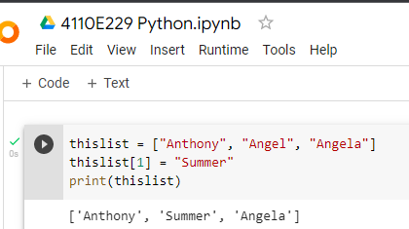
INTRODUCTION
Python – CHANGE ITEM VALUE
01
02
03
To change the value of a specific item, refer to the index number:
04
You can enter a subtitle here if you need it

Slide 46
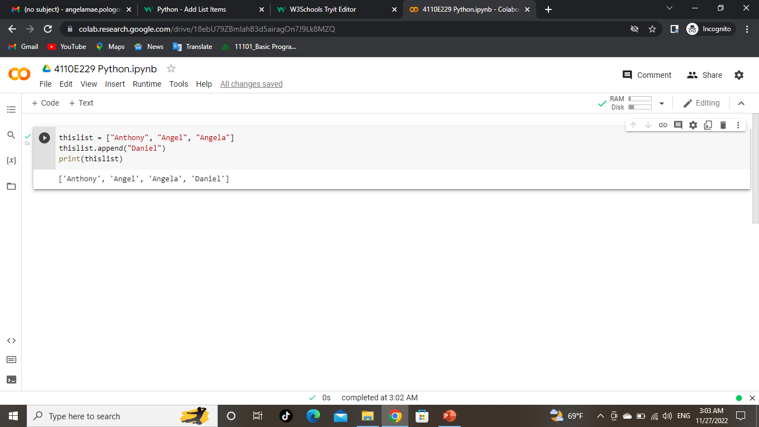
Python – ADD LIST ITEMS
01
02
03
To add an item to the end of the list, use the append() method:
04

Slide 47
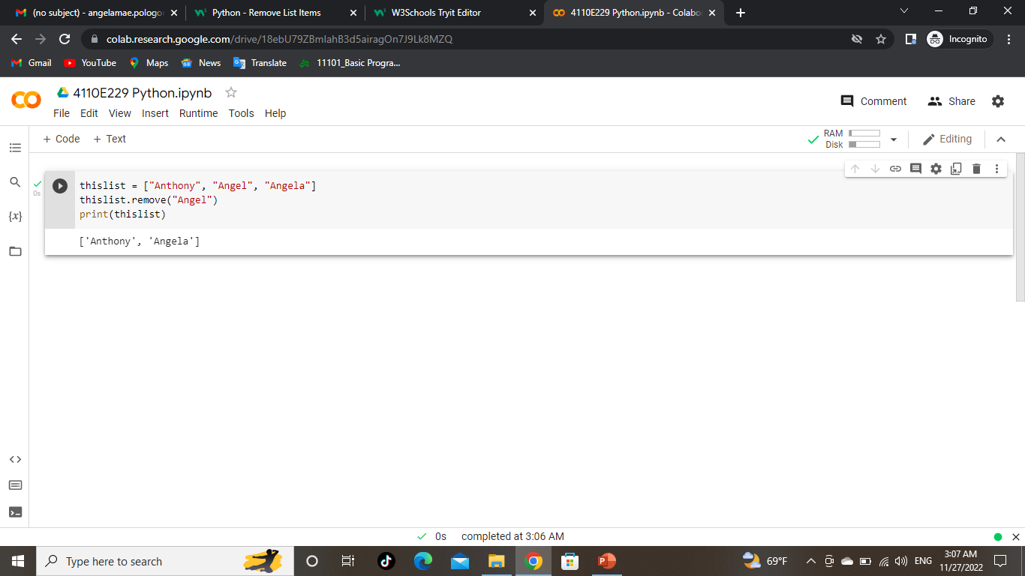
02.
PRESENTATION
Python – REMOVE LIST ITEMS
01
02
03
The remove() method removes the specified item.
04
You can enter a subtitle here if you need it
remove specified Item

Slide 48
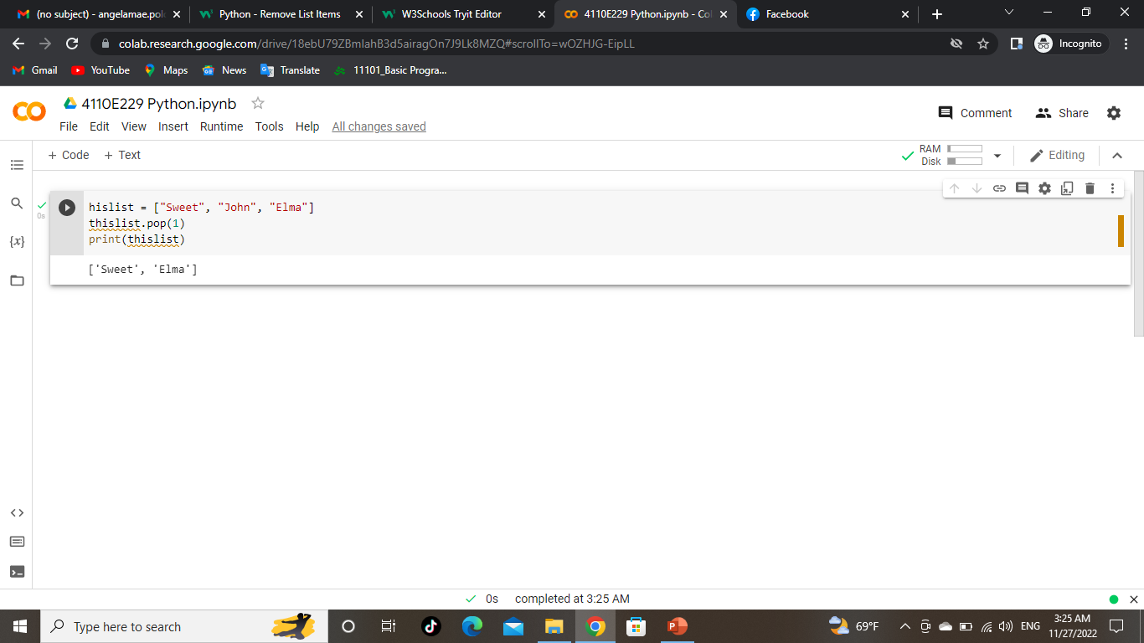
02.
PRESENTATION
Python – REMOVE LIST ITEMS
01
02
03
The remove() method removes the specified INDEX.
04
You can enter a subtitle here if you need it
remove specified INDEX

Slide 49
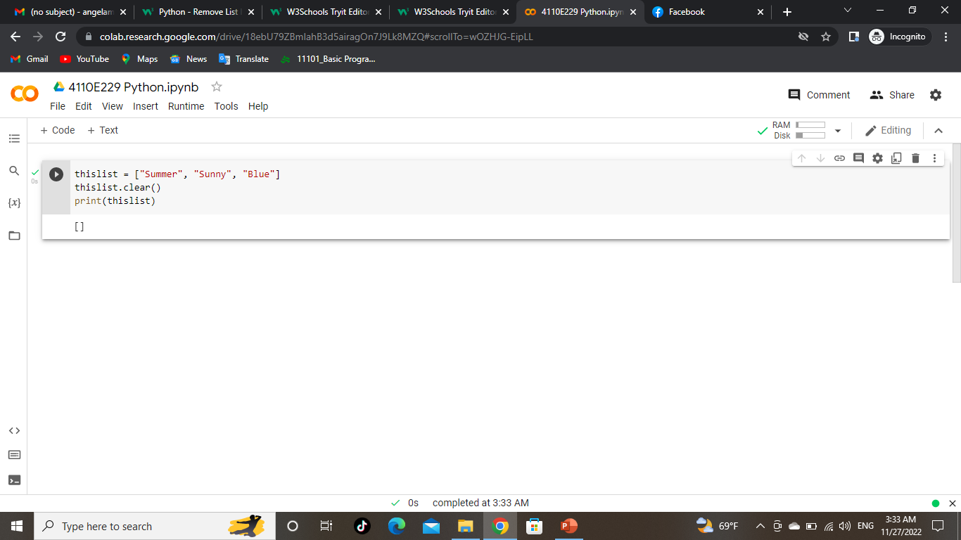
Python – REMOVE LIST ITEMS
CLEAR THE LIST
List items are indexed and you can access them by referring to the index number:
01
02
03
04
The clear() method empties the list.
The list still remains, but it has no content.

Slide 50

Python – LOOP LISTS
01
02
MARS
03
Mars is a very cold place
04
MERCURY
Loop Through a List
Mercury is the smallest planet
You can loop through the list items by using a for loop:

Slide 51

Python LOOP Lists
01
02
MARS
Despite being red, Mars is a cold place
03
04
Loop Through the Index Numbers
You can also loop through the list items by
referring to their index number.
Use the range() and len() functions to create
a suitable iterable.

Slide 52
Python LOOP Lists
01
02
MARS
Despite being red, Mars is a cold place
03
04
Loop Through the Index Numbers
You can also loop through the list items by
referring to their index number.
Use the range() and len() functions to create
a suitable iterable.

Slide 53

Python - loop Lists
Using a While Loop
01
You can loop through the list items by using a while loop.
Use the len() function to determine the length of the list, then start at 0 and loop your way through the list items by referring to their indexes.
Remember to increase the index by 1 after each iteration
02
03
04

Slide 54

02.
PRESENTATION
Python – loop LISTS
01
02
03
04
Looping Using List Comprehension
List Comprehension offers the shortest syntax for looping through lists:
You can enter a subtitle here if you need it

Slide 55
Python –LIST comprehension
01
02
List comprehension offers a shorter syntax when you want to create a new list based on the values of an existing list.
Example:
Based on a list of fruits, you want a new list, containing only the fruits with the letter "a" in the name.
Without list comprehension you will have to write a for statement with a conditional test inside:
03
04

Slide 56

Python –LIST comprehension
01
02
List comprehension offers a shorter syntax when you want to create a new list based on the values of an existing list.
Example:
Based on a list of fruits, you want a new list, containing only the fruits with the letter "a" in the name.
Without list comprehension you will have to write a for statement with a conditional test inside:
03
04

Slide 57
PYTHON - TUPLES
“
”

Slide 58
TUPLE
“
Tuples are used to store multiple items in a single variable.
Tuple is one of 4 built-in data types in Python used to store collections of data, the other 3 are List, Set, and Dictionary, all with different qualities and usage.
A tuple is a collection which is ordered and unchangeable.
Tuples are written with round brackets.
”

Slide 59

03.
ANALYSIS
TUPLES
01
02
03
04
You can enter a subtitle here if you need it

Slide 60
Tuple Items
Tuple items are ordered, unchangeable, and allow duplicate values.
Tuple items are indexed, the first item has index [0], the second item has index [1] etc.
Ordered
When we say that tuples are ordered, it means that the items have a defined order, and that order will not change.
Unchangeable
Tuples are unchangeable, meaning that we cannot change, add or remove items after the tuple has been created.

Slide 61

03.
ANALYSIS
ALLOW DUPLICATES
01
02
03
Since tuples are indexed, they can have items with the same value:
04
You can enter a subtitle here if you need it

Slide 62

03.
ANALYSIS
Tuple length
01
02
03
Since tuples are indexed, they can have items with the same value:
To determine how many items a tuple has, use the len() function:
04
You can enter a subtitle here if you need it

Slide 63

03.
ANALYSIS
Create tuple with one item
01
02
03
Since tuples are indexed, they can have items with the same value:
To determine how many items a tuple has, use the len() function:
04
You can enter a subtitle here if you need it

Slide 64

03.
ANALYSIS
Tuple items-data type
01
02
03
Since tuples are indexed, they can have items with the same value:
To determine how many items a tuple has, use the len() function:
Tuple items can be of any data type:
String, int and boolean data types:
04
You can enter a subtitle here if you need it

Slide 65

03.
ANALYSIS
Tuple items-data type
01
02
A tuple can contain different data types:
- with strings, integers and boolean values:
03
Since tuples are indexed, they can have items with the same value:
04
You can enter a subtitle here if you need it

Slide 66

03.
ANALYSIS
Type()
01
02
A tuple can contain different data types:
- with strings, integers and boolean values:
From Python's perspective, tuples are defined as objects with the data type 'tuple':
03
Since tuples are indexed, they can have items with the same value:
04
You can enter a subtitle here if you need it

Slide 67

03.
The tuple() Constructor
01
02
A tuple can contain different data types:
03
Using the tuple() method to make a tuple:
04
You can enter a subtitle here if you need it

Slide 68
There are four collection data types in the Python programming language:
List is a collection which is ordered and changeable. Allows duplicate members.
Tuple is a collection which is ordered and unchangeable. Allows duplicate members.
Set is a collection which is unordered, unchangeable*, and unindexed. No duplicate members.
Dictionary is a collection which is ordered** and changeable. No duplicate members.
Python Collections (Arrays)

Slide 69
PYTHON – access TUPLE itemS
“
”

Slide 70

03.
access TUPLE itemS
01
02
A tuple can contain different data types:
03
Using the tuple() method to make a tuple:
04
You can enter a subtitle here if you need it
You can access tuple items by referring to the index number, inside square brackets:

Slide 71

03.
NEGATIVE INDEXING
01
02
A tuple can contain different data types:
03
Using the tuple() method to make a tuple:
04
You can enter a subtitle here if you need it
Negative indexing means start from the end.
-1 refers to the last item, -2 refers to the second last item etc.
You can access tuple items by referring to the index number, inside square brackets:

Slide 72

03.
Range of indexes
01
02
A tuple can contain different data types:
You can specify a range of indexes by specifying where to start and where to end the range.
When specifying a range, the return value will be
a new tuple with the specified items.
03
Using the tuple() method to make a tuple:
04
You can enter a subtitle here if you need it
Negative indexing means start from the end.
-1 refers to the last item, -2 refers to the second last item etc.
You can access tuple items by referring to the index number, inside square brackets:

Slide 73

03.
Range of negative indexes
01
02
A tuple can contain different data types:
Specify negative indexes if you want to start
the search from the end of the tuple:
03
Using the tuple() method to make a tuple:
04

Slide 74

03.
Check if item values
01
02
A tuple can contain different data types:
To determine if a specified item is present in a tuple use the in keyword:
03
Using the tuple() method to make a tuple:
04

Slide 75
PYTHON – update TUPLEs
“
”
Tuples are unchangeable, meaning that you cannot change, add, or remove items once the tuple is created.

Slide 76

03.
ChANGE TUPLE values
01
02
A tuple can contain different data types:
To determine if a specified item is present in a tuple use the in keyword:
03
Using the tuple() method to make a tuple:
04
Once a tuple is created, you cannot change its values. Tuples are unchangeable, or immutable as it also is called.
But there is a workaround.
You can convert the tuple into a list, change the list, and convert the list back into a tuple.

Slide 77

03.
Add items
Since tuples are immutable, they do not have a build-in append()
method, but there are other ways to add items to a tuple.
1. Convert into a list: Just like the workaround for changing a tuple, you can convert it into a list, add your item(s), and convert it back into a tuple.
01
02
A tuple can contain different data types:
To determine if a specified item is present in a tuple use the in keyword:
03
Using the tuple() method to make a tuple:
04

Slide 78

03.
Add items
Since tuples are immutable, they do not have a build-in append()
method, but there are other ways to add items to a tuple.
2. Add tuple to a tuple. You are allowed to add tuples to tuples, so if you want to add one item, (or many), create a new tuple with the item(s), and add it to the existing tuple:
01
02
A tuple can contain different data types:
To determine if a specified item is present in a tuple use the in keyword:
03
Using the tuple() method to make a tuple:
04

Slide 79


03.
remove items
Tuples are unchangeable, so you cannot remove items from it, but you can use the same workaround as we used for changing and adding tuple items:
01
02
A tuple can contain different data types:
To determine if a specified item is present in a tuple use the in keyword:
03
Using the tuple() method to make a tuple:
04
Error: because the tuple no longer exists

Slide 80
PYTHON – unpack TUPLEs
“
”

Slide 81

03.
Unpacking tuples
When we create a tuple, we normally assign values to it.
This is called "packing" a tuple:
01
02
A tuple can contain different data types:
To determine if a specified item is present in a tuple use the in keyword:
03
Using the tuple() method to make a tuple:
04

Slide 82

03.
Unpacking tuples
But, in Python, we are also allowed to extract the values back into variables. This is called "unpacking":
01
02
A tuple can contain different data types:
To determine if a specified item is present in a tuple use the in keyword:
03
Using the tuple() method to make a tuple:
04

Slide 83

03.
Using asterisk
If the number of variables is less than the number of values, you can add an * to the variable name and the values will be assigned to the variable as a list:
01
02
A tuple can contain different data types:
To determine if a specified item is present in a tuple use the in keyword:
03
Using the tuple() method to make a tuple:
04

Slide 84

03.
Using asterisk
If the asterisk is added to another variable name than the last, Python will assign values to the variable until the number of values left matches the number of variables left.
01
02
A tuple can contain different data types:
To determine if a specified item is present in a tuple use the in keyword:
03
Using the tuple() method to make a tuple:
04

Slide 85
PYTHON – loop TUPLEs
“
”

Slide 86

03.
Loop through a tuples
You can loop through the tuple items by using a for loop.
01
02
A tuple can contain different data types:
To determine if a specified item is present in a tuple use the in keyword:
03
Using the tuple() method to make a tuple:
04

Slide 87

03.
Loop through the
index numbers
01
02
A tuple can contain different data types:
To determine if a specified item is present in a tuple use the in keyword:
03
Using the tuple() method to make a tuple:
04
You can also loop through the tuple items by referring to their index number.
Use the range() and len() functions to create a suitable iterable.

Slide 88

03.
Using a while Loop
01
02
A tuple can contain different data types:
To determine if a specified item is present in a tuple use the in keyword:
03
Using the tuple() method to make a tuple:
04
You can loop through the list items by using a while loop.
Use the len() function to determine the length of the tuple, then start at 0 and loop your way through the tuple items by refering to their indexes.
Remember to increase the index by 1 after each iteration.

Slide 89
PYTHON – join TUPLEs
“
”

Slide 90

03.
Join two tuples
To join two or more tuples you can use the + operator:
01
02
A tuple can contain different data types:
To determine if a specified item is present in a tuple use the in keyword:
03
Using the tuple() method to make a tuple:
04

Slide 91

03.
Multiply tuples
If you want to multiply the content of a tuple a given number of times, you can use the * operator:
01
02
A tuple can contain different data types:
To determine if a specified item is present in a tuple use the in keyword:
03
Using the tuple() method to make a tuple:
04

Slide 92
PYTHON –TUPLE methods
“
”

Slide 93

03.
Tuple methods
Python has two built-in methods that you can use on tuples.
01
02
A tuple can contain different data types:
To determine if a specified item is present in a tuple use the in keyword:
03
Using the tuple() method to make a tuple:
04

Slide 94
PYTHON – sets
“
”

Slide 95
set
01
Sets are used to store multiple items in a single variable.
Set is one of 4 built-in data types in Python used to store collections of data, the other 3 are List, Tuple, and Dictionary, all with different qualities and usage.
A set is a collection which is unordered, unchangeable*, and unindexed.
02
A tuple can contain different data types:
To determine if a specified item is present in a tuple use the in keyword:
03
Using the tuple() method to make a tuple:
04

Slide 96

set
01
Sets are used to store multiple items in a single variable.
Set is one of 4 built-in data types in Python used to store collections of data, the other 3 are List, Tuple, and Dictionary, all with different qualities and usage.
A set is a collection which is unordered, unchangeable*, and unindexed.
02
A tuple can contain different data types:
To determine if a specified item is present in a tuple use the in keyword:
Sets are written with curly brackets.
03
Using the tuple() method to make a tuple:
04

Slide 97
sets
Set items are unordered, unchangeable, and do not allow duplicate values.
Unordered means that the items in a set do not have a defined order.
Set items can appear in a different order every time you use them, and cannot be referred to by index or key.
Unchangeable
Set items are unchangeable, meaning that we cannot change the items after the set has been created.
01
02
A tuple can contain different data types:
To determine if a specified item is present in a tuple use the in keyword:
03
Using the tuple() method to make a tuple:
04

Slide 98

03.
Duplicates not allowed
Sets cannot have two items with the same value.
01
02
A tuple can contain different data types:
To determine if a specified item is present in a tuple use the in keyword:
03
Using the tuple() method to make a tuple:
04

Slide 99
PYTHON – access set items
“
”

Slide 100

03.
Access items
01
02
A tuple can contain different data types:
To determine if a specified item is present in a tuple use the in keyword:
03
Using the tuple() method to make a tuple:
04
You cannot access items in a set by referring to an index or a key.
But you can loop through the set items using a for loop, or ask if a specified value is present in a set, by using the in keyword.

Slide 101

03.
add items
01
02
A tuple can contain different data types:
To determine if a specified item is present in a tuple use the in keyword:
03
Using the tuple() method to make a tuple:
04
Once a set is created, you cannot change its items, but you can add new items.
To add one item to a set use the add() method.

Slide 102

03.
add sets
01
To add items from another set into the current set, use the update() method.
02
A tuple can contain different data types:
To determine if a specified item is present in a tuple use the in keyword:
03
Using the tuple() method to make a tuple:
04

Slide 103

03.
add any iterable
01
The object in the update() method does not have to be a set, it can be any iterable object (tuples, lists, dictionaries etc.).
To add items from another set into the current set, use the update() method.
02
A tuple can contain different data types:
To determine if a specified item is present in a tuple use the in keyword:
03
Using the tuple() method to make a tuple:
04

Slide 104

03.
Remove set items
01
To add items from another set into the current set, use the update() method.
02
A tuple can contain different data types:
To remove an item in a set, use the remove(), or the discard() method.
To determine if a specified item is present in a tuple use the in keyword:
03
Using the tuple() method to make a tuple:
04

Slide 105

03.
Remove set items
01
To add items from another set into the current set, use the update() method.
02
A tuple can contain different data types:
Same result but different method
To determine if a specified item is present in a tuple use the in keyword:
03
Using the tuple() method to make a tuple:
04

Slide 106
03.
Remove set items
01
To add items from another set into the current set, use the update() method.
02
A tuple can contain different data types:
Same result but different method
To determine if a specified item is present in a tuple use the in keyword:
03
Using the tuple() method to make a tuple:
04

Slide 107

03.
Remove set items
01
Remove the last item by using the pop() method:
To add items from another set into the current set, use the update() method.
02
A tuple can contain different data types:
To determine if a specified item is present in a tuple use the in keyword:
03
Using the tuple() method to make a tuple:
04
Note: Sets are unordered, so when using the pop() method, you do not know which item that gets removed.

Slide 108

03.
Remove set items
01
Remove the last item by using the pop() method:
To add items from another set into the current set, use the update() method.
02
A tuple can contain different data types:
The clear() method empties the set:
To determine if a specified item is present in a tuple use the in keyword:
03
Using the tuple() method to make a tuple:
04

Slide 109

03.
Remove set items
The del keyword will delete the set completely:
01
Remove the last item by using the pop() method:
To add items from another set into the current set, use the update() method.
02
A tuple can contain different data types:
The clear() method empties the set:
To determine if a specified item is present in a tuple use the in keyword:
03
Using the tuple() method to make a tuple:
04
It will raise an error because the set no longer exists

Slide 110

03.
Loop set items
01
Loop through the set, and print the values:
To add items from another set into the current set, use the update() method.
02
A tuple can contain different data types:
To determine if a specified item is present in a tuple use the in keyword:
03
Using the tuple() method to make a tuple:
04

Slide 111
JOINT sets
01
There are several ways to join two or more sets in Python.
You can use the union() method that returns a new set containing all items from both sets, or the update() method that inserts all the items from one set into another:
02
03
04

Slide 112

03.
join two sets
01
To add items from another set into the current set, use the update() method.
02
A tuple can contain different data types:
The union() method returns a new set with all items from both sets:
To determine if a specified item is present in a tuple use the in keyword:
03
Using the tuple() method to make a tuple:
04

Slide 113

03.
join two sets
01
To add items from another set into the current set, use the update() method.
02
A tuple can contain different data types:
The union() method returns a new set with all items from both sets:
The update() method inserts the items in set2 into set1:
To determine if a specified item is present in a tuple use the in keyword:
03
Using the tuple() method to make a tuple:
04

Slide 114

03.
join two sets
Keep ONLY the Duplicates
The intersection update() method will keep only the items that are present in both sets.
01
To add items from another set into the current set, use the update() method.
02
A tuple can contain different data types:
The union() method returns a new set with all items from both sets:
The update() method inserts the items in set2 into set1:
To determine if a specified item is present in a tuple use the in keyword:
03
Using the tuple() method to make a tuple:
04

Slide 115

03.
join two sets
The intersection() method will return a new set, that only contains the items that are present in both sets.
01
To add items from another set into the current set, use the update() method.
02
A tuple can contain different data types:
The union() method returns a new set with all items from both sets:
The update() method inserts the items in set2 into set1:
Return a set that contains the items that exist in both set x, and set y:
To determine if a specified item is present in a tuple use the in keyword:
03
Using the tuple() method to make a tuple:
04

Slide 116

join two sets
Keep All, But NOT the Duplicates
The symmetric difference update() method will keep only the elements that are NOT present in both sets.
01
To add items from another set into the current set, use the update() method.
02
A tuple can contain different data types:
The union() method returns a new set with all items from both sets:
The update() method inserts the items in set2 into set1:
To determine if a specified item is present in a tuple use the in keyword:
03
Using the tuple() method to make a tuple:
04

Slide 117

join two sets
Keep All, But NOT the Duplicates
The symmetric difference update() method will keep only the elements that are NOT present in both sets.
Keep All, But NOT the Duplicates
The symmetric difference() method will return a new set, that contains only the elements that are NOT present in both sets.
01
To add items from another set into the current set, use the update() method.
02
A tuple can contain different data types:
The union() method returns a new set with all items from both sets:
The update() method inserts the items in set2 into set1:
To determine if a specified item is present in a tuple use the in keyword:
03
Using the tuple() method to make a tuple:
04

Slide 118

Set methods
Python has a set of built-in methods that you can use on sets.
01
02
03
04

Slide 119
PYTHON – dictionaries
“
”

Slide 120

Dictionary items
Dictionary items are ordered, changeable, and does not allow duplicates.
Dictionary items are presented in key:value pairs, and can be referred to by using the key name.
01
02
03
04

Slide 121
Dictionary items
01
Ordered or Unordered?
As of Python version 3.7, dictionaries are ordered. In Python 3.6 and earlier, dictionaries are unordered.
When we say that dictionaries are ordered, it means that the items have a defined order, and that order will not change.
Unordered means that the items does not have a defined order, you cannot refer to an item by using an index.
Changeable
Dictionaries are changeable, meaning that we can change, add or remove items after the dictionary has been created.
02
03
04

Slide 122

Dictionary items
01
Dictionaries cannot have two items with the same key:
02
03
04

Slide 123

Dictionary LENGTH
01
Dictionaries cannot have two items with the same key:
To determine how many items a dictionary has, use the len() function:
02
03
04

Slide 124


Dictionaries are used to store data values in key:value pairs.
A dictionary is a collection which is ordered*, changeable and do not allow duplicates.
As of Python version 3.7, dictionaries are ordered.
In Python 3.6 and earlier, dictionaries are unordered.
Dictionaries are written with curly brackets, and have keys and values:
Data types: Dictionary
01
02
03
04
key
value
key:value pairs

Slide 125

type()
From Python's perspective, dictionaries are defined as objects with the data type 'dict':
01
Dictionaries cannot have two items with the same key:
To determine how many items a dictionary has, use the len() function:
02
03
04

Slide 126

The dict() Constructor
From Python's perspective, dictionaries are defined as objects with the data type 'dict':
01
Dictionaries cannot have two items with the same key:
To determine how many items a dictionary has, use the len() function:
02
03
04

Slide 127
List is a collection which is ordered and changeable. Allows duplicate members.
Python Collections (Arrays)
There are four collection data types in the Python programming language:
01
02
03
Tuple is a collection which is ordered and unchangeable. Allows duplicate members.
04
Set is a collection which is unordered, unchangeable*, and unindexed. No duplicate members.
Dictionary is a collection which is ordered** and changeable. No duplicate members.

Slide 128


Access dictionary items
You can access the items of a dictionary by referring to its key name, inside square brackets:
There is also a method called get() that will give you the same result:
01
Dictionaries cannot have two items with the same key:
To determine how many items a dictionary has, use the len() function:
02
03
04

Slide 129


GET KEYS
The keys() method will return a list of all the keys in the dictionary.
The list of the keys is a view of the dictionary, meaning that any changes done to the dictionary will be reflected in the keys list.
01
02
03
04

Slide 130

Python - Change Dictionary Items
Change VALUES
01
02
03
04
You can change the value of a specific item by referring to its key name:

Slide 131

Python - Change Dictionary Items
Update Dictionary
01
02
03
04
The update() method will update the dictionary with the items from the given argument.
The argument must be a dictionary, or an iterable object with key:value pairs.

Slide 132

Python - Add Dictionary Items
Adding Items
01
02
03
04
Adding an item to the dictionary is done by using a new index key and assigning a value to it:

Slide 133

Python - Add Dictionary Items
Update dictionary
01
02
03
04
The update() method will update the dictionary with the items from a given argument. If the item does not exist, the item will be added.
The argument must be a dictionary, or an iterable object with key:value pairs.

Slide 134


Python - remove Dictionary Items
Removing Items
01
There are several methods to remove items from a dictionary:
02
The popitem() method removes the last inserted item
(in versions before 3.7, a random item is removed instead):
03
The pop() method removes the item with the specified key name:
04

Slide 135

Python - remove Dictionary Items
Removing Items
01
There are several methods to remove items from a dictionary:
02
03
04
The del keyword removes the item with the specified key name:

Slide 136


Python - remove Dictionary Items
Removing Items
01
There are several methods to remove items from a dictionary:
02
The del keyword can also delete the dictionary completely:
03
The pop() method removes the item with the specified key name:
The clear() method empties the dictionary:
04

Slide 137


Python - LOOP DictionarIES
Loop Through a Dictionary
01
There are several methods to remove items from a dictionary:
02
You can loop through a dictionary by using a for loop.
When looping through a dictionary, the return value are the keys of the dictionary, but there are methods to return the values as well.
Print all values in the dictionary, one by one:
03
The clear() method empties the dictionary:
04

Slide 138


Python - LOOP DictionarIES
Loop Through a Dictionary
01
There are several methods to remove items from a dictionary:
02
You can also use the values() method to return values of a dictionary:
You can use the keys() method to return the keys of a dictionary:
03
The clear() method empties the dictionary:
04

Slide 139

Python - LOOP DictionarIES
Loop Through a Dictionary
01
There are several methods to remove items from a dictionary:
02
03
The clear() method empties the dictionary:
04
Loop through both keys and values, by using the items() method:

Slide 140

Python - COPY DictionarIES
Copy a Dictionary
01
02
You cannot copy a dictionary simply by typing dict2 = dict1, because: dict2 will only be a reference to dict1, and changes made in dict1 will automatically also be made in dict2.
There are ways to make a copy, one way is to use the built-in Dictionary method copy().
03
The clear() method empties the dictionary:
04
Make a copy of a dictionary with the copy() method:

Slide 141

Python - COPY DictionarIES
Copy a Dictionary
01
02
SAME RESULT BUT DIFFERENT METHOD
03
04
Make a copy of a dictionary with the dict() function:

Slide 142

Python - NESTED DictionarIES
A dictionary can contain dictionaries, this is called nested dictionaries.
01
Create a dictionary that contain three dictionaries:
02
03
04

Slide 143

Python - NESTED DictionarIES
A dictionary can contain dictionaries, this is called nested dictionaries.
01
Create three dictionaries, then create one dictionary that will contain the other three dictionaries:
02
03
04

Slide 144

Python – DictionarY METHODS
Python has a set of built-in methods that you can use on dictionaries.
01
02
03
04

Slide 145
PYTHON If ... Else
“
”

Slide 146

Python If ... Else
Python Conditions and If statements
Python supports the usual logical conditions from mathematics:
Equals: a == b
Not Equals: a != b
Less than: a < b
Less than or equal to: a <= b
Greater than: a > b
Greater than or equal to: a >= b
These conditions can be used in several ways, most commonly in "if statements" and loops.
An "if statement" is written by using the if keyword.
01
02
03
04

Slide 147

Python If ... Else
Indentation
Python relies on indentation (whitespace at the beginning of a line) to define scope in the code. Other programming languages often use curly-brackets for this purpose.
01
02
03
04
If statement, without indentation (will raise an error):

Slide 148

Python If ... Else
ELIF
The elif keyword is pythons way of saying "if the previous conditions were not true, then try this condition".
01
02
03
04
In this example a is equal to b, so the first condition is not true, but the elif condition is true, so we print to screen that "a and b are equal".

Slide 149

Python If ... Else
ELSE
The else keyword catches anything which isn't caught by the preceding conditions.
01
02
03
04
In this example a is equal to b, so the first condition is not true, but the elif condition is true, so we print to screen that "a and b are equal".

Slide 150

Python If ... Else
ELSE
01
02
03
04
You can also have an else without the elif:

Slide 151

Python If ... Else
SHORT HAND IF
If you have only one statement to execute, you can put it on the same line as the if statement.
01
02
03
04

Slide 152


Python If ... Else
SHORT HAND IF ELSE
If you have only one statement to execute,
you can put it on the same line as the if statement.
01
02
You can also have multiple else statements on the same line:
03
04

Slide 153


Python If ... Else
AND
The and keyword is a logical operator, and is
used to combine conditional statements:
OR
The or keyword is a logical operator, and is used to combine conditional statements:
01
02
03
04

Slide 154


Python If ... Else
Nested If
You can have if statements inside if statements, this is called nested if statements.
The pass Statement
if statements cannot be empty, but if you for some reason have an if statement with no content, put in the pass statement to avoid getting an error.
01
02
03
04

Slide 155
Python While Loops
“
”

Slide 156
PYTHON LOOPS
01
02
Python has two primitive loop commands:
while loops
for loops
03
04

Slide 157

THE WHILE LOOP
With the while loop we can execute a set of statements as long as a condition is true.
01
02
03
04
Note: remember to increment i, or else the loop will continue forever.

Slide 158

The break Statement
With the break statement we can stop the loop even if the while condition is true:
01
02
03
04

Slide 159

The continue Statement
With the continue statement we can stop the current iteration, and continue with the next:
01
02
03
04

Slide 160

The ELSE Statement
With the else statement we can run a block of code once when the condition no longer is true:
01
02
03
04

Slide 161
Python FOR Loops
“
”

Slide 162

Python FOR Loops
A for loop is used for iterating over a sequence (that is either a list, a tuple, a dictionary, a set, or a string).
This is less like the for keyword in other programming languages, and works more like an iterator method as found in other object-orientated programming languages.
With the for loop we can execute a set of statements, once for each item in a list, tuple, set etc.
01
02
03
The for loop does not require an indexing variable to set beforehand.
04

Slide 163

Looping Through a String
Even strings are iterable objects, they contain a sequence of characters:
01
02
03
04

Slide 164

The break Statement
With the break statement we can stop the loop before it has looped through all the items:
01
02
03
04

Slide 165

The break Statement
Exit the loop when x is “pink", but this time the break comes before the print:
01
02
03
04

Slide 166

The continue Statement
01
With the continue statement we can stop the current iteration of the loop, and continue with the next:
02
03
04

Slide 167

The range() Function
01
02
03
To loop through a set of code a specified number of times, we can use the range() function,
The range() function returns a sequence of numbers, starting from 0 by default, and increments by 1 (by default), and ends at a specified number.
04
Note that range(6) is not the values of 0 to 6, but the values 0 to 5.

Slide 168

The range() Function
The range() function defaults to 0 as a starting value, however it is possible to specify the starting value by adding a parameter: range(2, 6), which means values from 2 to 6 (but not including 6):
01
Using the start parameter:
02
03
04

Slide 169

The range() Function
The range() function defaults to increment the sequence by 1, however it is possible to specify the increment value by adding a third parameter: range(4, 36, 6):
01
02
03
04

Slide 170

Else in For Loop
The else keyword in a for loop specifies a block of code to be executed when the loop is finished:
01
02
03
04

Slide 171

Else in For Loop
Break the loop when x is 3, and see what happens with the else block:
01
02
03
04

Slide 172

Nested Loops
A nested loop is a loop inside a loop.
The "inner loop" will be executed one time for each iteration of the "outer loop":
01
02
03
04

Slide 173

The pass Statement
for loops cannot be empty, but if you for some reason have a for loop with no content, put in the pass statement to avoid getting an error.
01
02
03
04

Slide 174
Python Functions
“
”
A function is a block of code which only runs when it is called. You can pass data, known as parameters, into a function.
A function can return data as a result.

Slide 175


Creating a function
In Python a function is defined using the def keyword:
01
02
calling a function
03
04
To call a function, use the function name followed by parenthesis:

Slide 176

ARGUMENTS
Information can be passed into functions as arguments.
Arguments are specified after the function name, inside the parentheses. You can add as many arguments as you want, just separate them with a comma.
The following example has a function with one argument (fname). When the function is called, we pass along a first name, which is used inside the function to print the full name:
Example:
01
02
03
04
Arguments are often shortened to args in Python documentations.

Slide 177
01
PARAMETERS OR ARGUMENTS?
02
03
The terms parameter and argument can be used for the same thing: information that are passed into a function.
From a function's perspective:
A parameter is the variable listed inside the parentheses in the function definition.
An argument is the value that is sent to the function when it is called.
04

Slide 178


NUMBER OF ARGUMENTS
By default, a function must be called with the correct number of arguments. Meaning that if your function expects 2 arguments, you have to call the function with 2 arguments, not more, and not less.
If you try to call the function with 1 or 3 arguments, you will get an error:
01
02
03
If you try to call the function with 1 or 3 arguments, you will get an error:
04

Slide 179

Arbitrary arGUMENTS
01
If you do not know how many arguments that will be passed into your function, add a * before the parameter name in the function definition.
This way the function will receive a tuple of arguments, and can access the items accordingly:
02
03
04
Arguments are often shortened to args in Python documentations.

Slide 180

KEYWORD arGUMENTS
01
You can also send arguments with the key = value syntax.
This way the order of the arguments does not matter.
02
03
04
The phrase Keyword Arguments are often shortened to kwargs in Python documentations.

Slide 181

Arbitrary Keyword Arguments, **kwargs
If you do not know how many keyword arguments that will be passed into your function, add two asterisk: ** before the parameter name in the function definition.
This way the function will receive a dictionary of arguments, and can access the items accordingly:
01
02
03
04
Arbitrary Kword Arguments are often shortened to **kwargs in Python documentations.

Slide 182

Default Parameter Value
The following example shows how to use a default parameter value.
If we call the function without argument, it uses the default value:
01
02
03
04

Slide 183

Passing a List as an Argument
You can send any data types of argument to a function (string, number, list, dictionary etc.), and it will be treated as the same data type inside the function.
01
02
03
04

Slide 184

Return Values
01
To let a function return a value, use the return statement:
02
03
04

Slide 185

The pass Statement
function definitions cannot be empty, but if you for some reason have a function definition with no content, put in the pass statement to avoid getting an error.
01
02
03
04
having an empty function definition like this, would raise an error without the pass statement

Slide 186

recursion
“
Python also accepts function recursion, which means a defined function can call itself.
Recursion is a common mathematical and programming concept. It means that a function calls itself. This has the benefit of meaning that you can loop through data to reach a result.
The developer should be very careful with recursion as it can be quite easy to slip into writing a function which never terminates, or one that uses excess amounts of memory or processor power. However, when written correctly recursion can be a very efficient and mathematically-elegant approach to programming.
”

Slide 187
recursion
01
02
03
04
having an empty function definition like this, would raise an error without the pass statement

Slide 188
Python lambda
“
”
A lambda function is a small anonymous function.
A lambda function can take any number of arguments, but can only have one expression.

Slide 189



Syntax
lambda arguments : expression
The expression is executed and the result is returned:
01
02
03
Add 10 to argument a, and return the result:
Multiply argument a with argument b and return the result:
Summarize argument a, b, and c and return the result:
04
Lambda functions can take any number of arguments:

Slide 190



Why Use Lambda Functions?
The power of lambda is better shown when you use them as an anonymous function inside another function.
Say you have a function definition that takes one argument, and that argument will be multiplied with an unknown number:
01
02
03
04
Use that function definition to make a function that always doubles the number you send in:

Slide 191

Why Use Lambda Functions?
01
02
03
04
Use lambda functions when an anonymous function is required for a short period of time.

Slide 192
Python arrays
“
”

Slide 193

arrays
01
Arrays are used to store multiple values in one single variable:
02
03
04
Note: This page shows you how to use LISTS as ARRAYS, however, to work with arrays in Python you will have to import a library, like the NumPy library.

Slide 194
What is an array?
01
An array is a special variable, which can hold more than one value at a time.
If you have a list of items (a list of foods for example), storing the foods in single variables could look like this:
food1 = “Burger" food2 = “Pizza" food3 = “Cake"
However, what if you want to loop through the cars and find a specific one? And what if you had not 3 foods, but 300?
The solution is an array!
An array can hold many values under a single name, and you can access the values by referring to an index number.
02
03
04

Slide 195


Access the Elements of an Array
01
02
Get the value of the first array item:
Modify the value of the first array item:
03
04

Slide 196

The Length of an Array
01
Use the len() method to return the length of an array (the number of elements in an array).
02
03
04
Return the number of elements in the cars array:

Slide 197

Looping Array Elements
01
02
03
04
You can use the for in loop to loop through all the elements of an array.

Slide 198

Adding Array Elements
01
You can use the append() method to add an element to an array.
02
03
04

Slide 199


removing Array Elements
01
You can use the pop() method to remove an element from the array.
You can also use the remove() method to remove an element from the array.
02
03
04

Slide 200
Array Methods
Python has a set of built-in methods that you can use on lists/arrays.
Method | Description
append() | Adds an element at the end of the list
clear() | Removes all the elements from the list
copy() | Returns a copy of the list
count() | Returns the number of elements with the specified value
extend() | Add the elements of a list (or any iterable), to the end of the current list
index() | Returns the index of the first element with the specified value
insert() | Adds an element at the specified position
pop() | Removes the element at the specified position
remove() | Removes the first item with the specified value
reverse() | Reverses the order of the list
sort() | Sorts the list
01
02
03
04
Note: Python does not have built-in support for Arrays, but Python Lists can be used instead.

Slide 201
Thank you
Pologon, Angela Mae
安希佐
S#4110E229 angelamae.pologon@gmail.com

